Slide 1
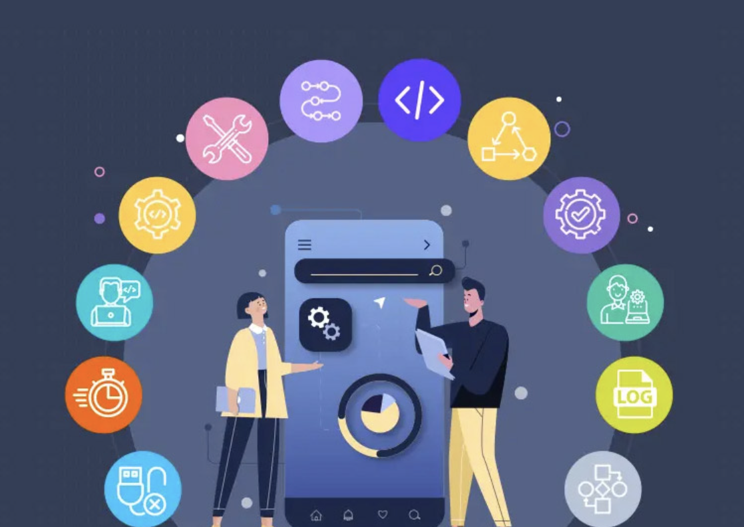
12-Factor Approach for Microservices

Slide 2

Amarjeet Singh Arora
Amarjeet Singh has 17+ Years as a Software Development and Corporate Trainer with training experience on Java, J2EE with National and Overseas clients. He has provided services to 200+ clients across the globe and handled 550+ batches and served in Analytical and Technical capabilities during the course of his career,
Core Java
J2EE – RMI, Servlet, JSP, EJB
Struts
EJB 3.0
Jboss Seam
Spring
Spring MVC & Hibernate
Angular.JS. Node. JS and XML web services

Slide 3
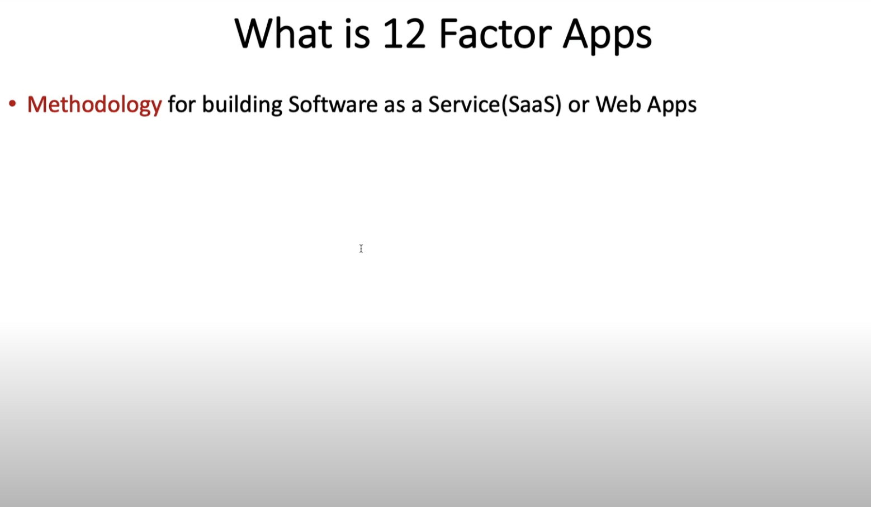

Slide 4
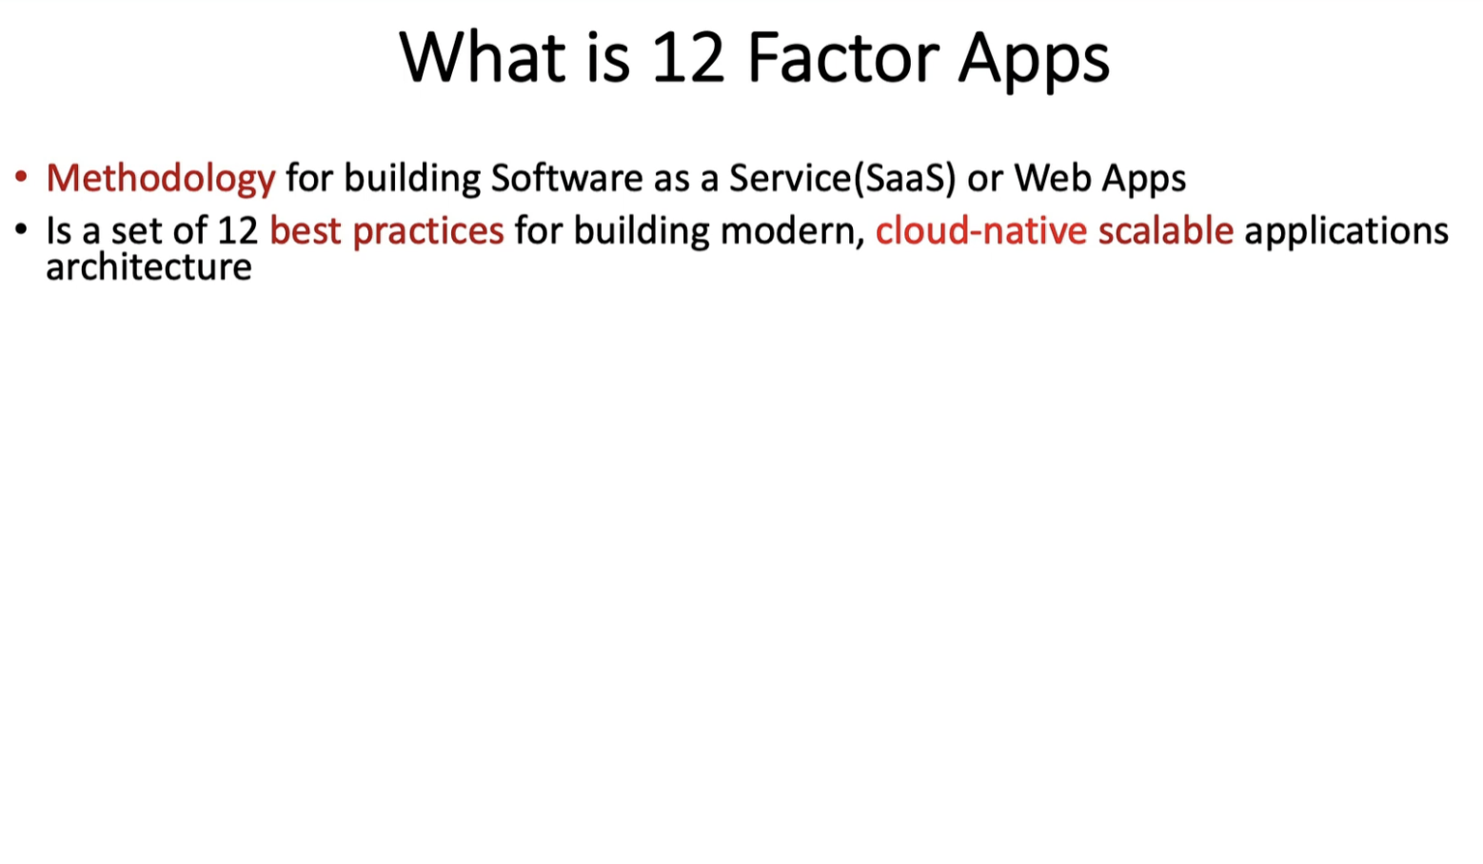

Slide 5
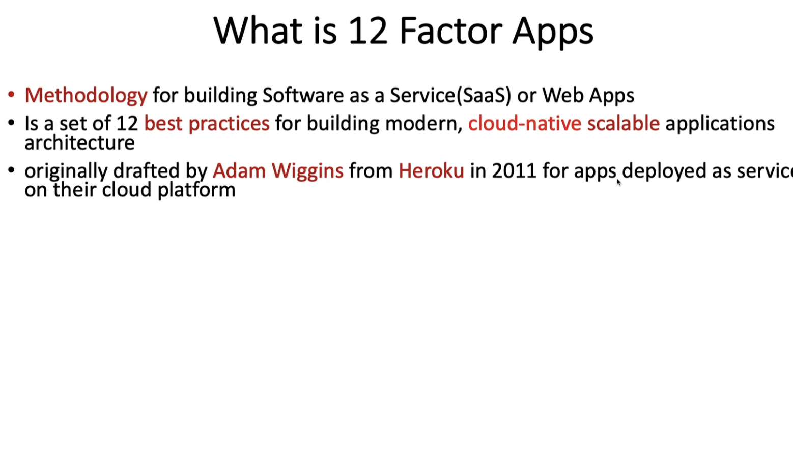

Slide 6
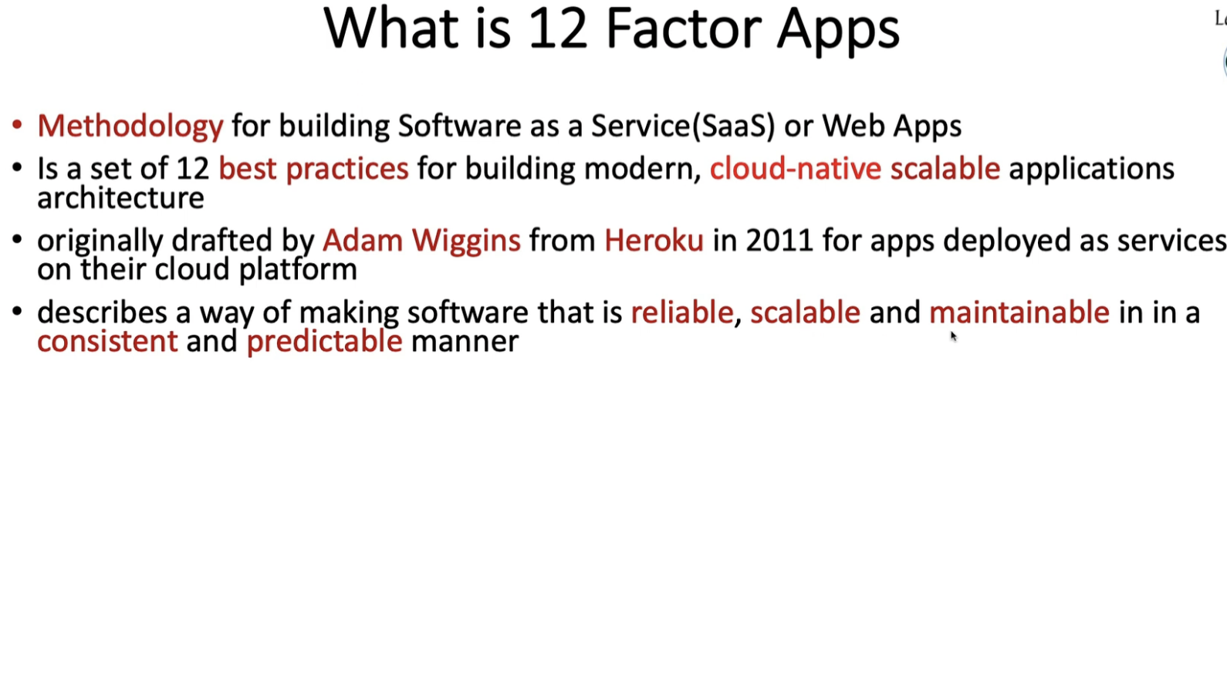

Slide 7
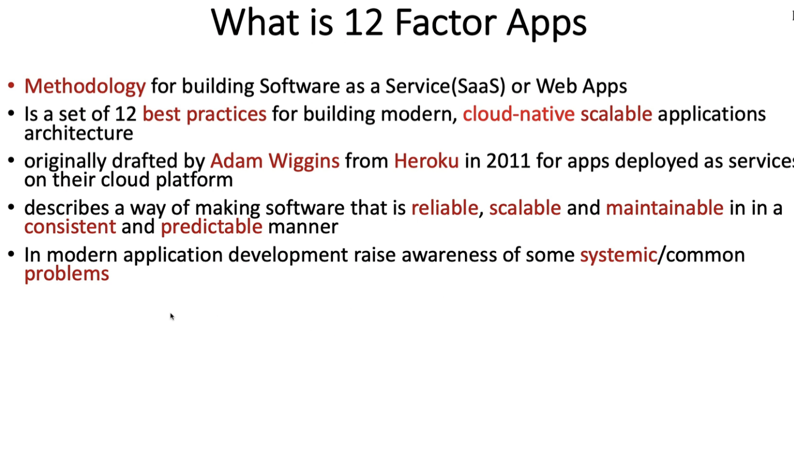

Slide 8
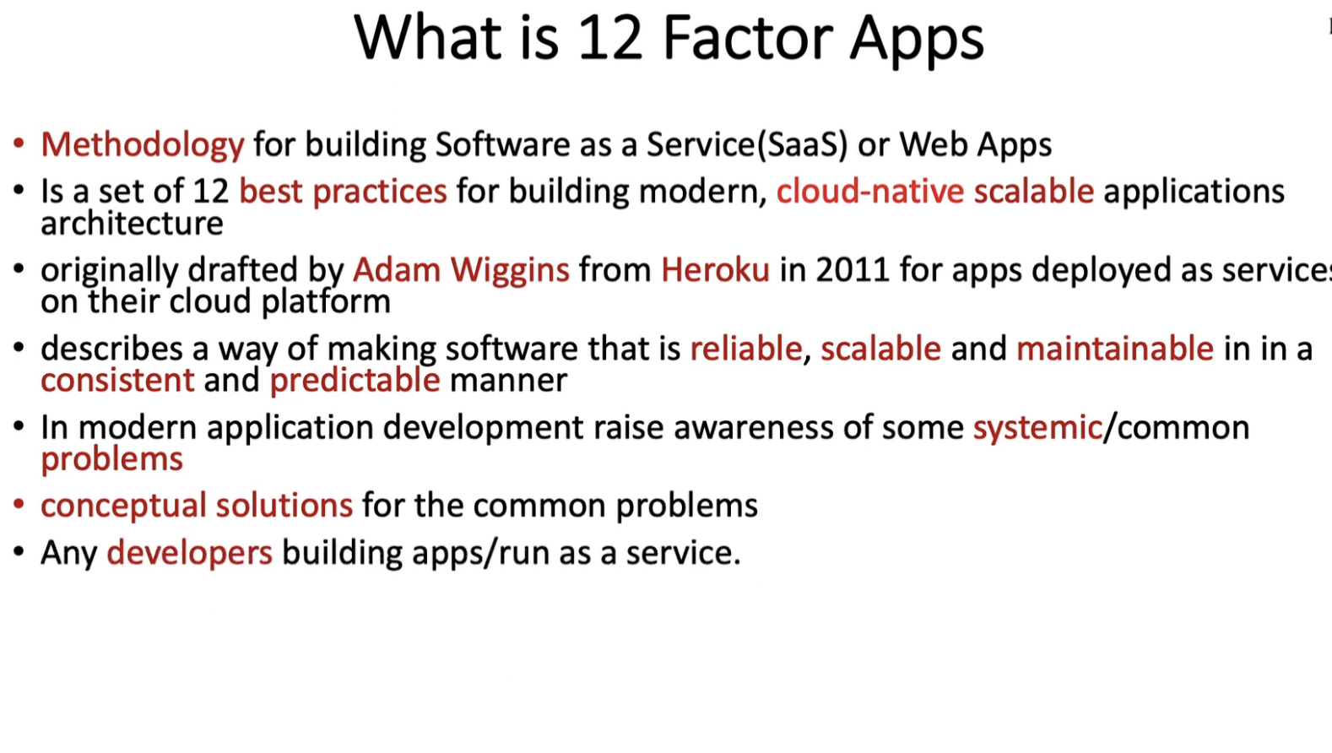

Slide 9
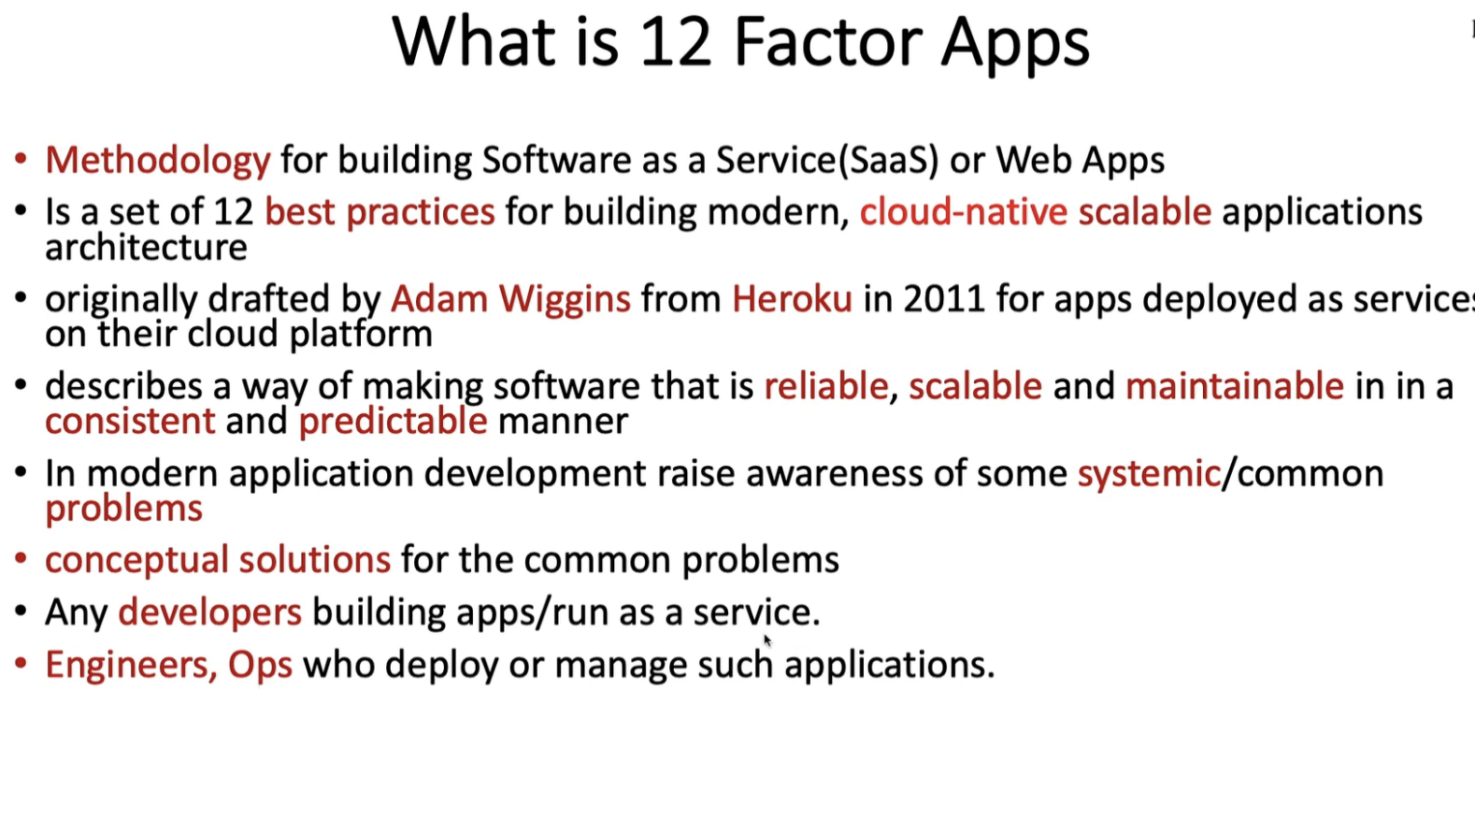

Slide 10
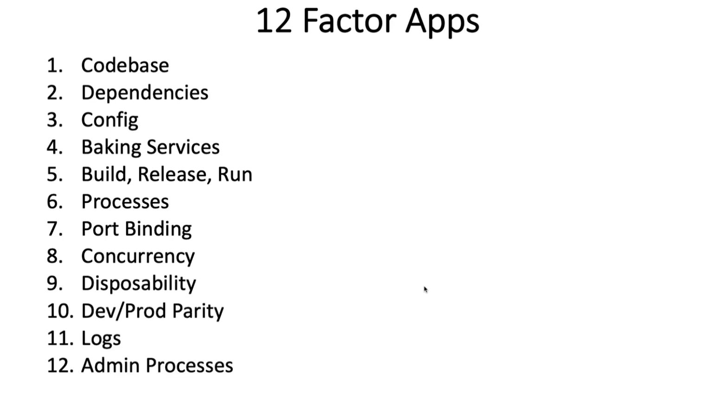

Slide 11
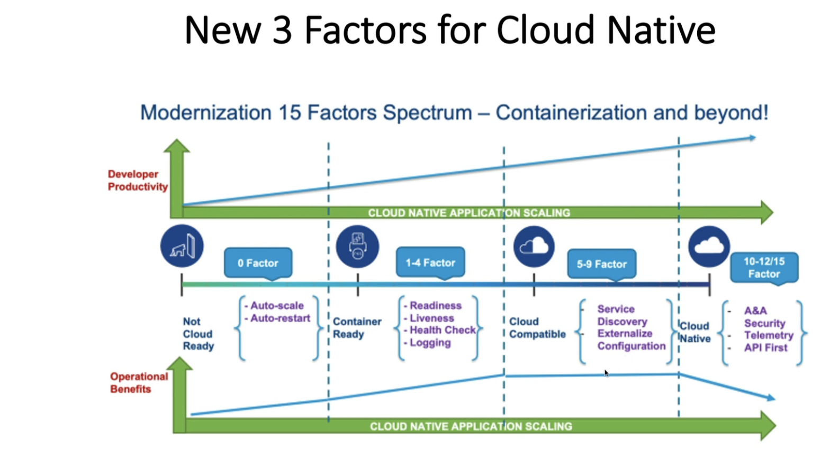

Slide 12
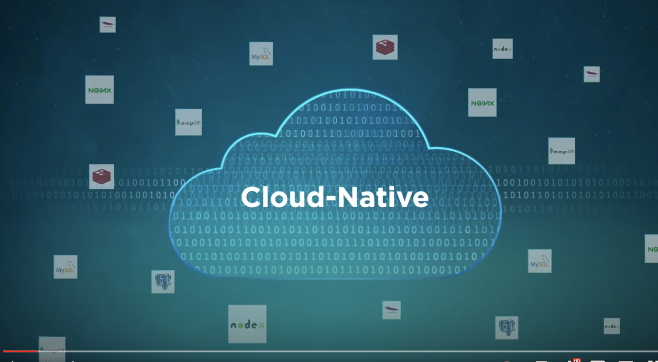

Slide 13
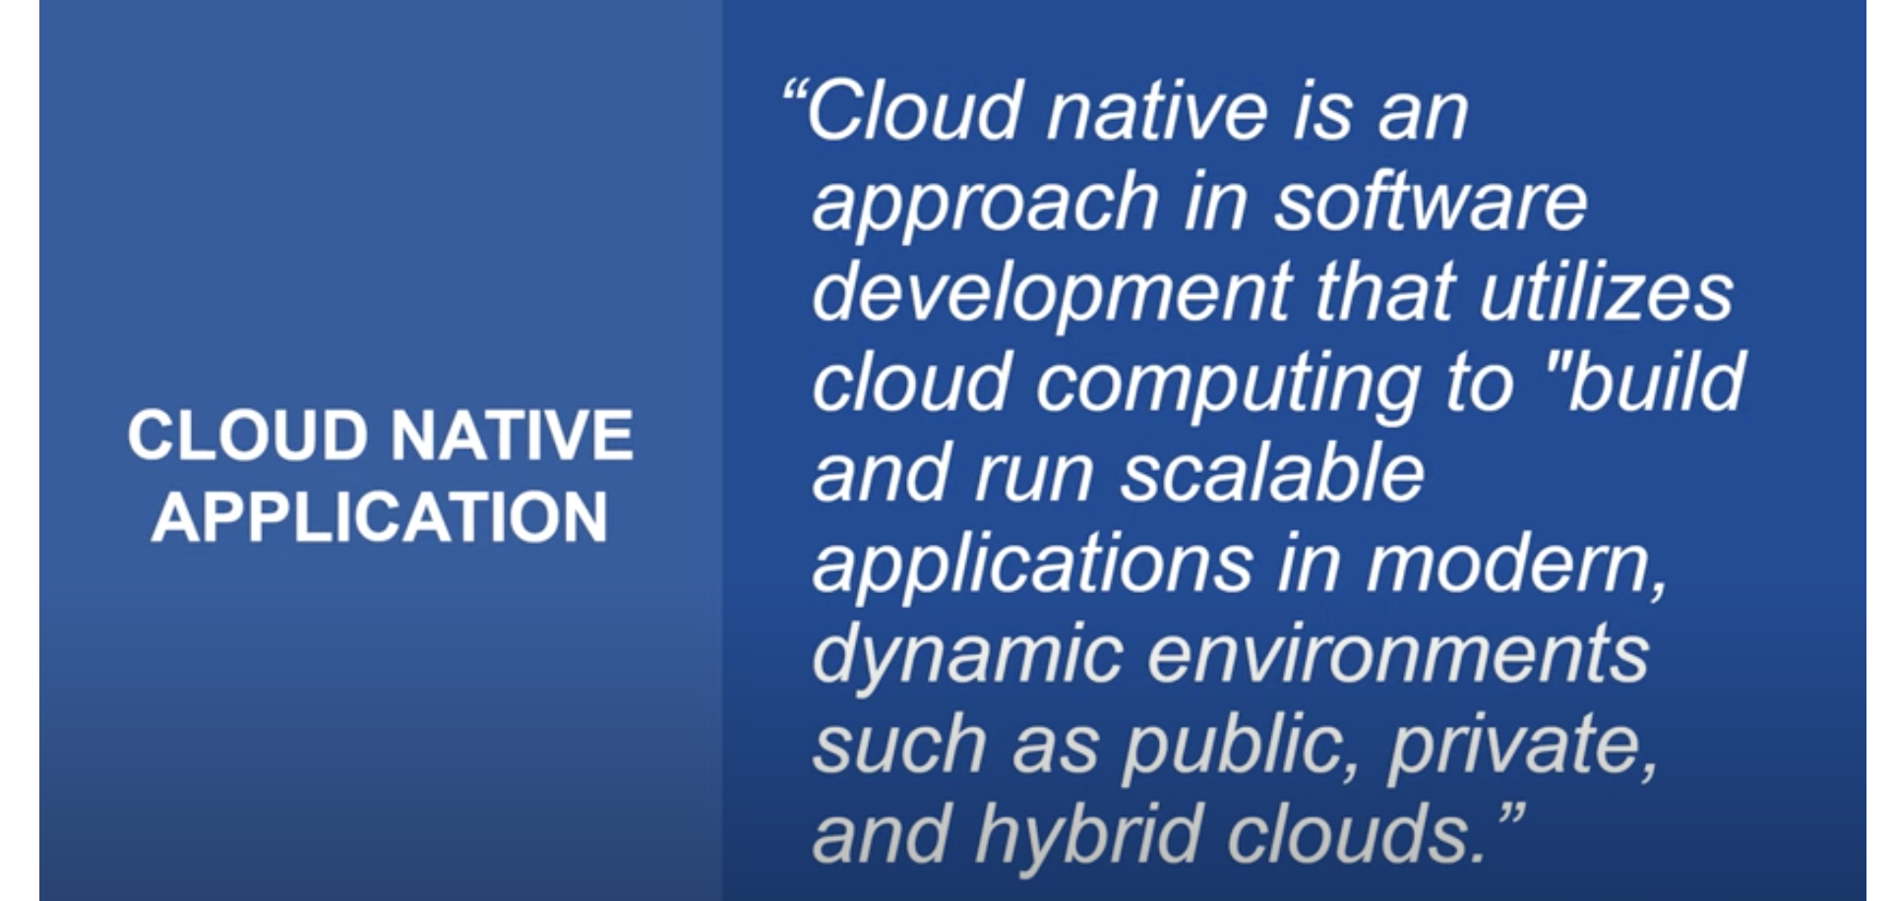

Slide 14
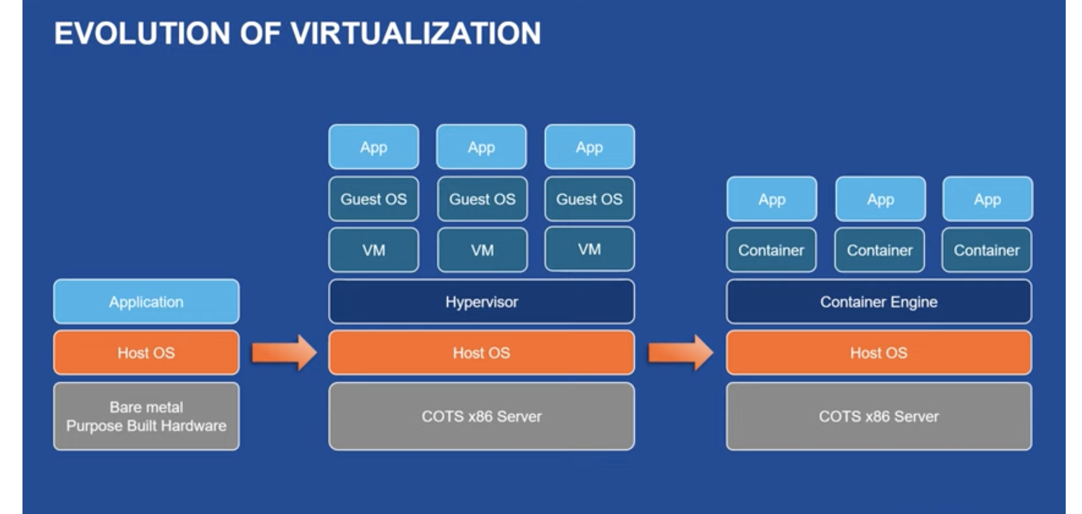

Slide 15
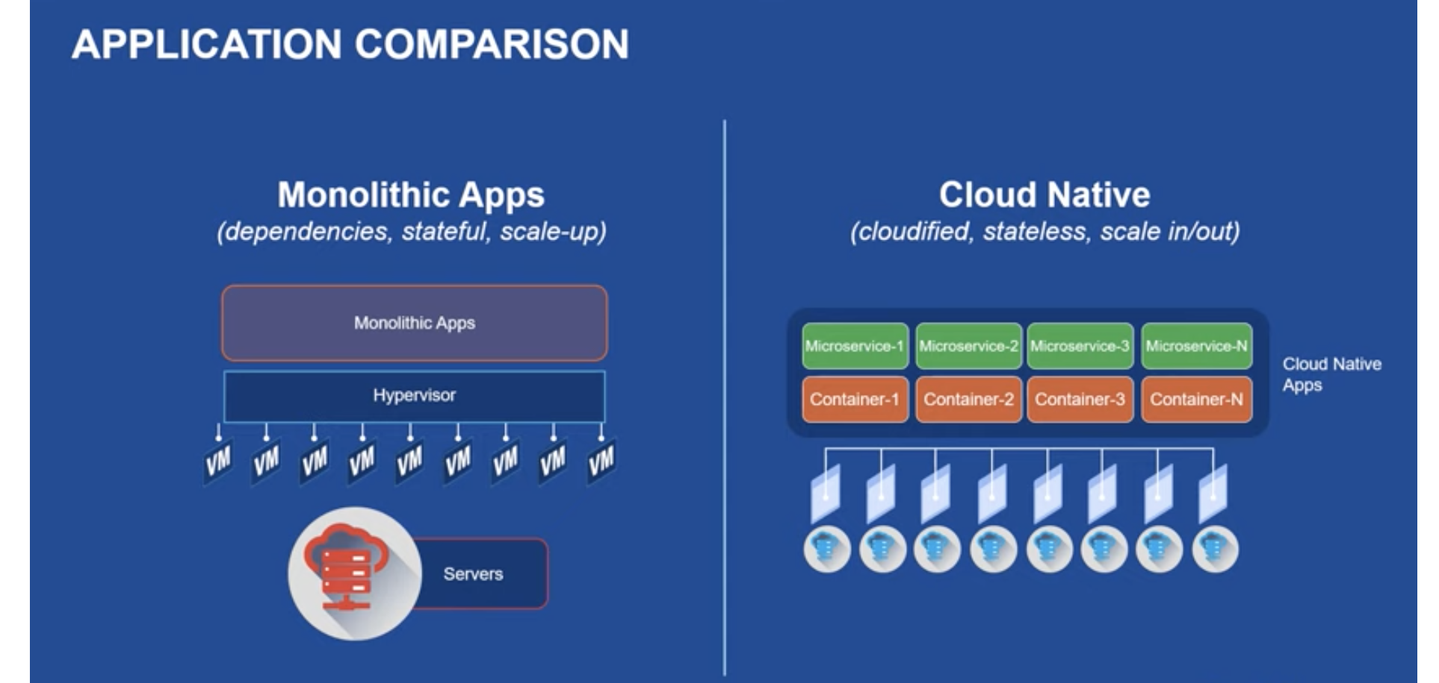

Slide 16
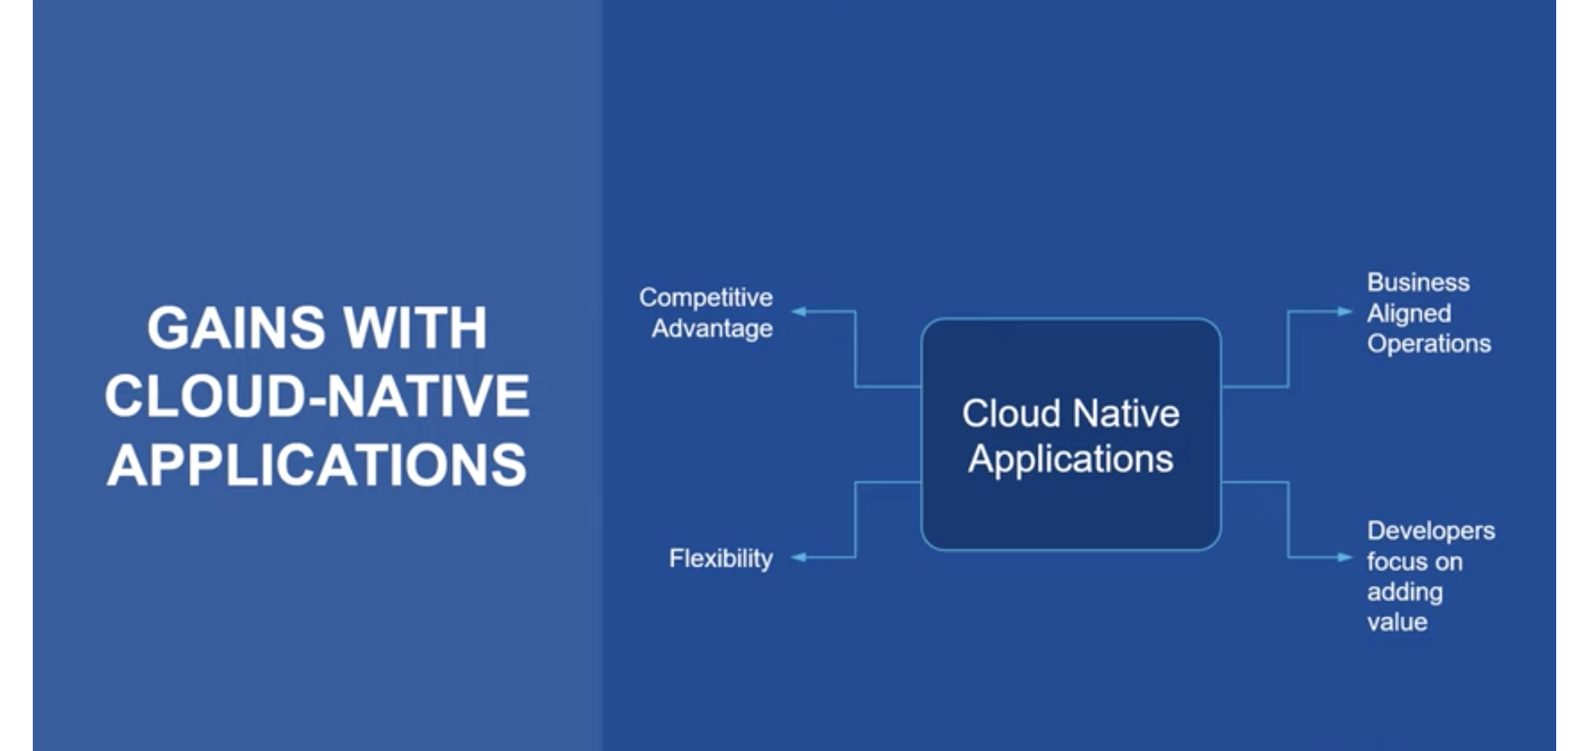

Slide 17
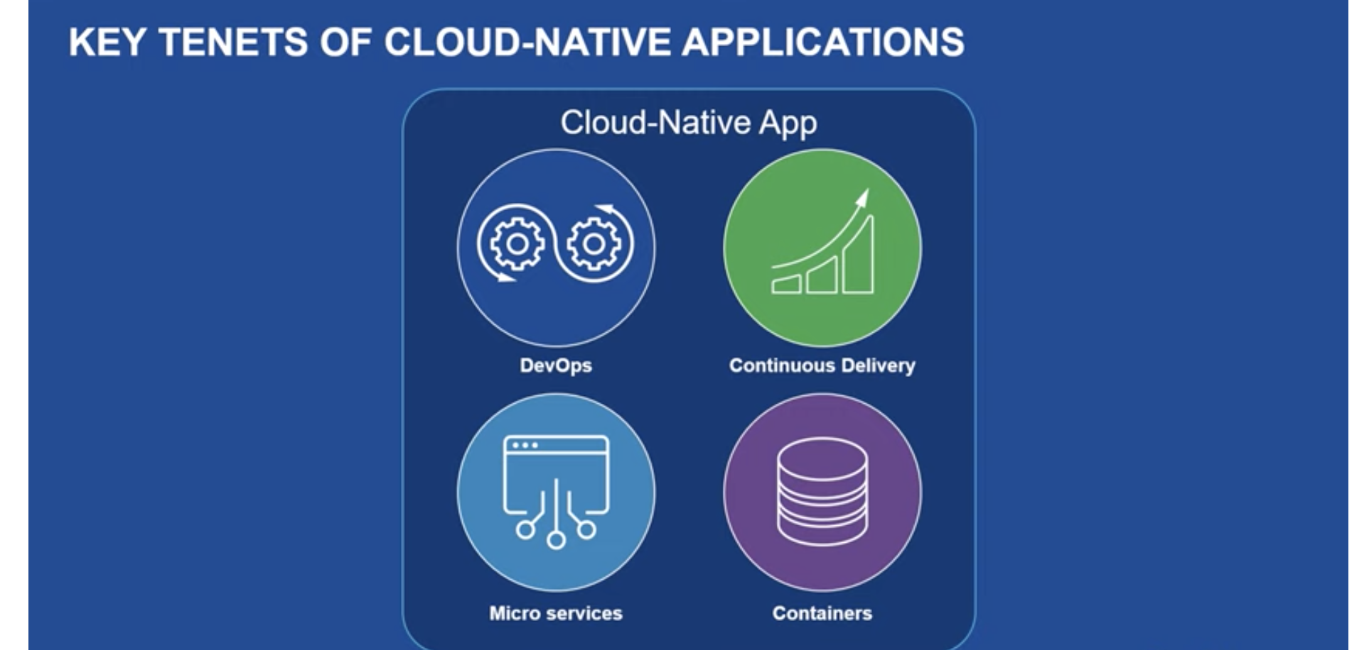

Slide 18
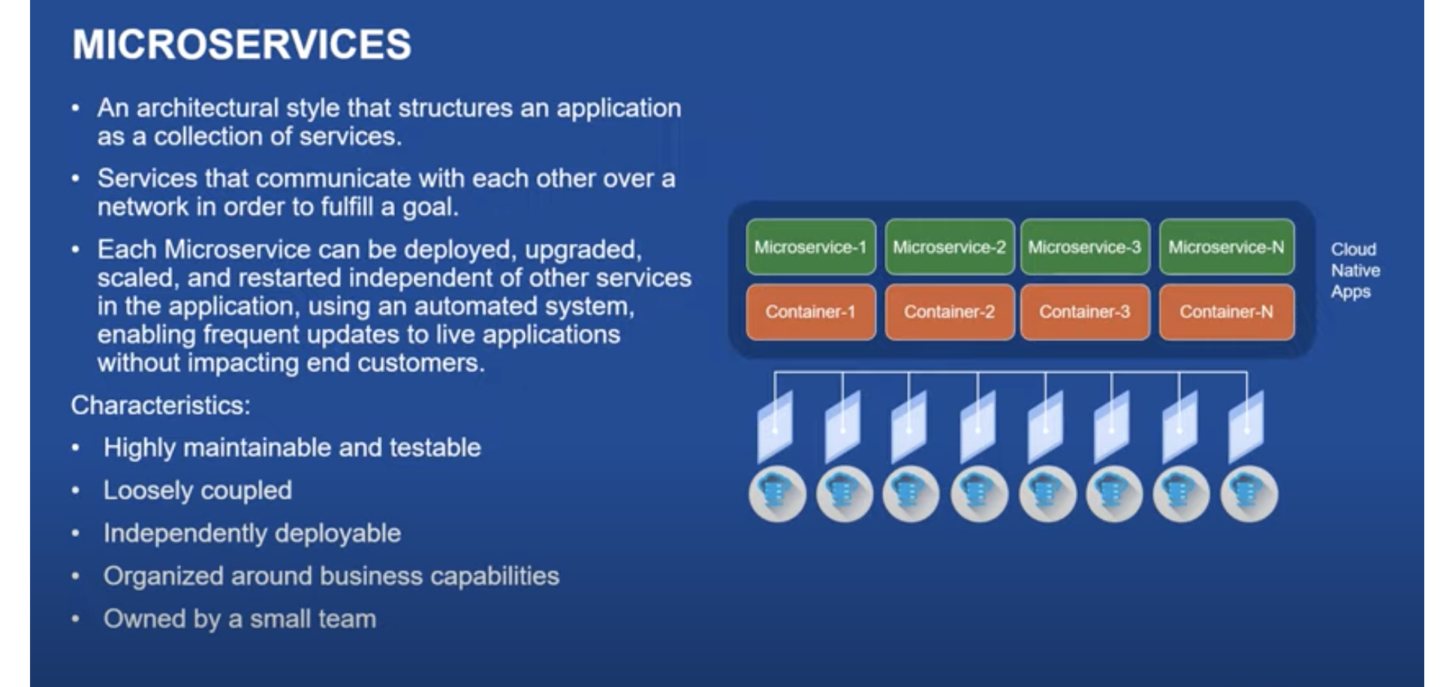

Slide 19
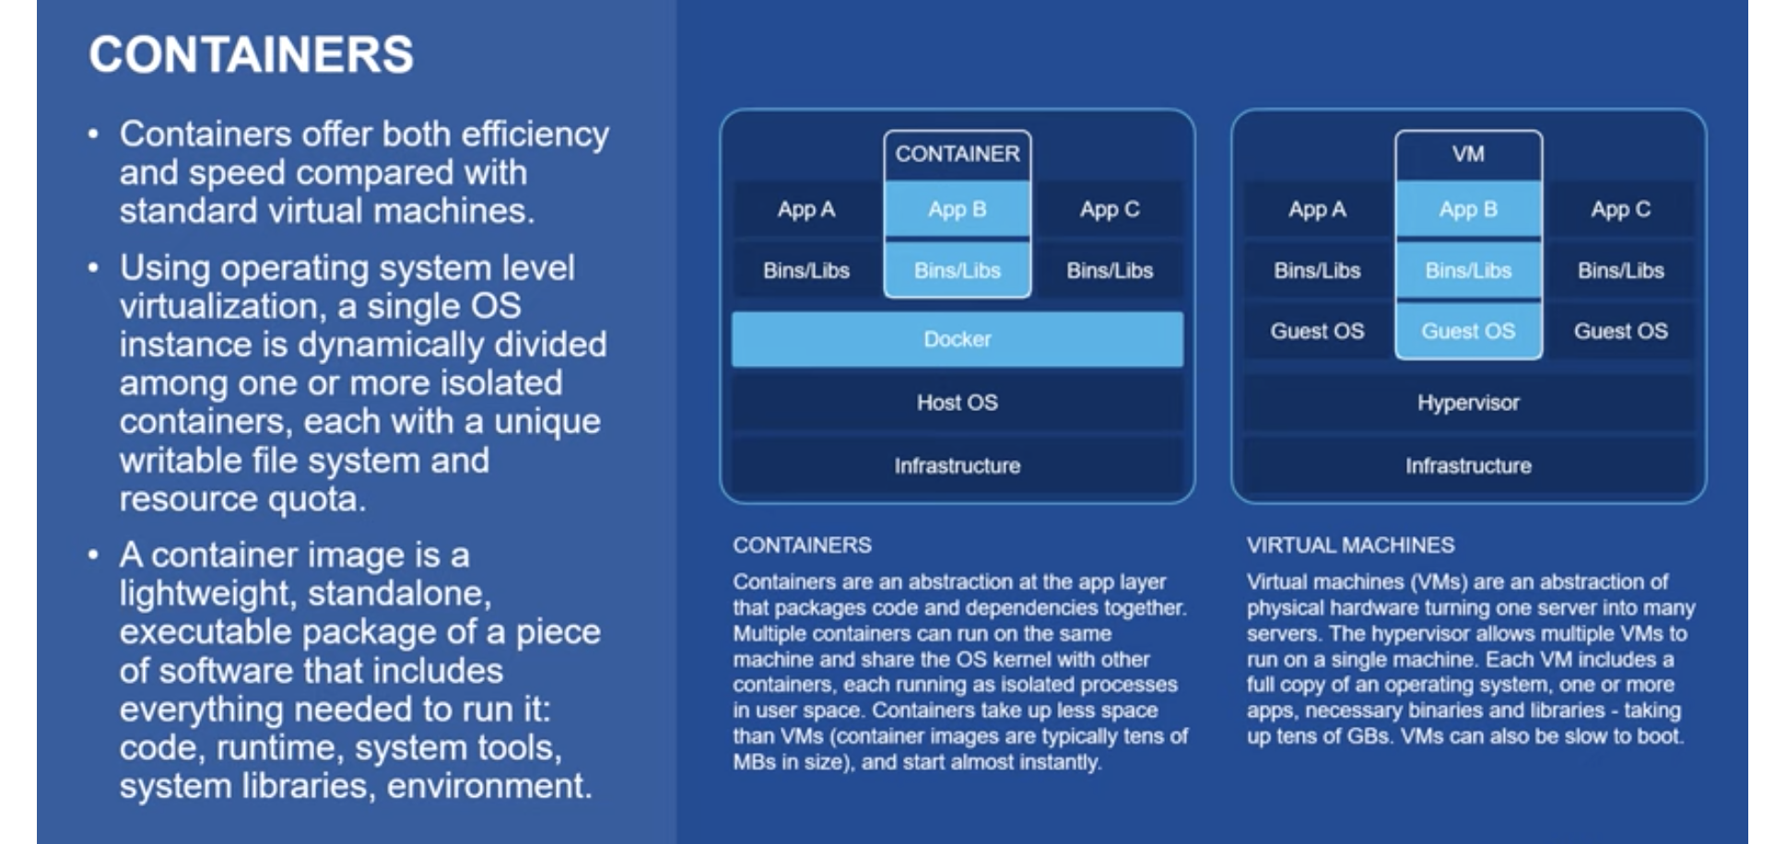

Slide 20
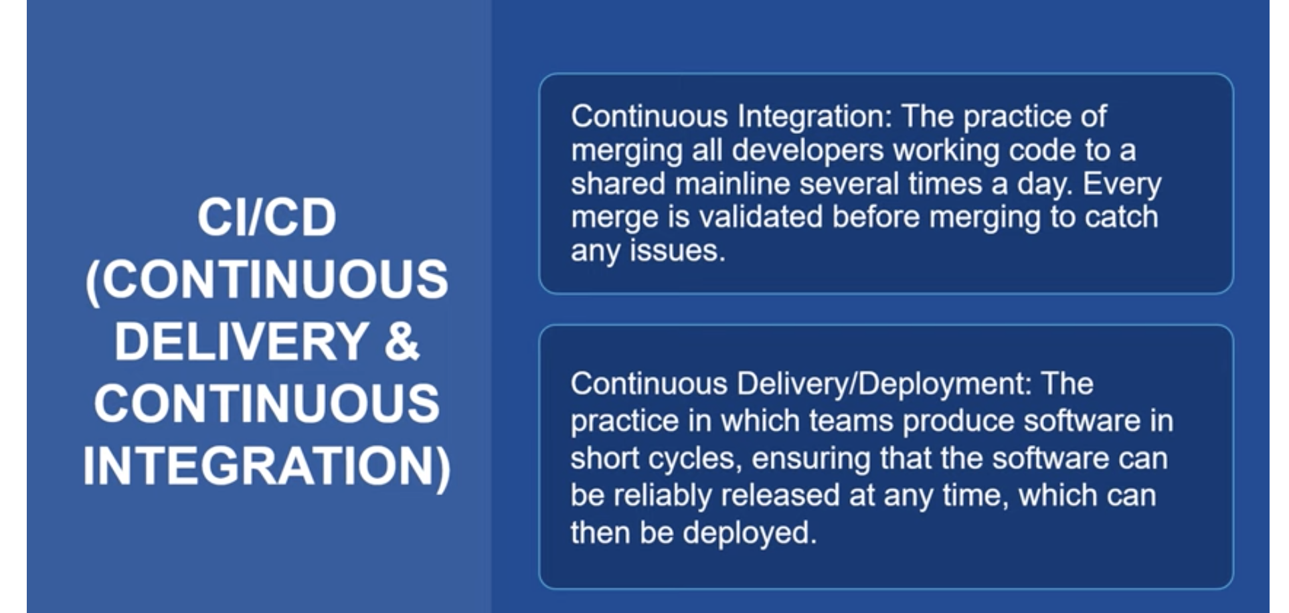

Slide 21
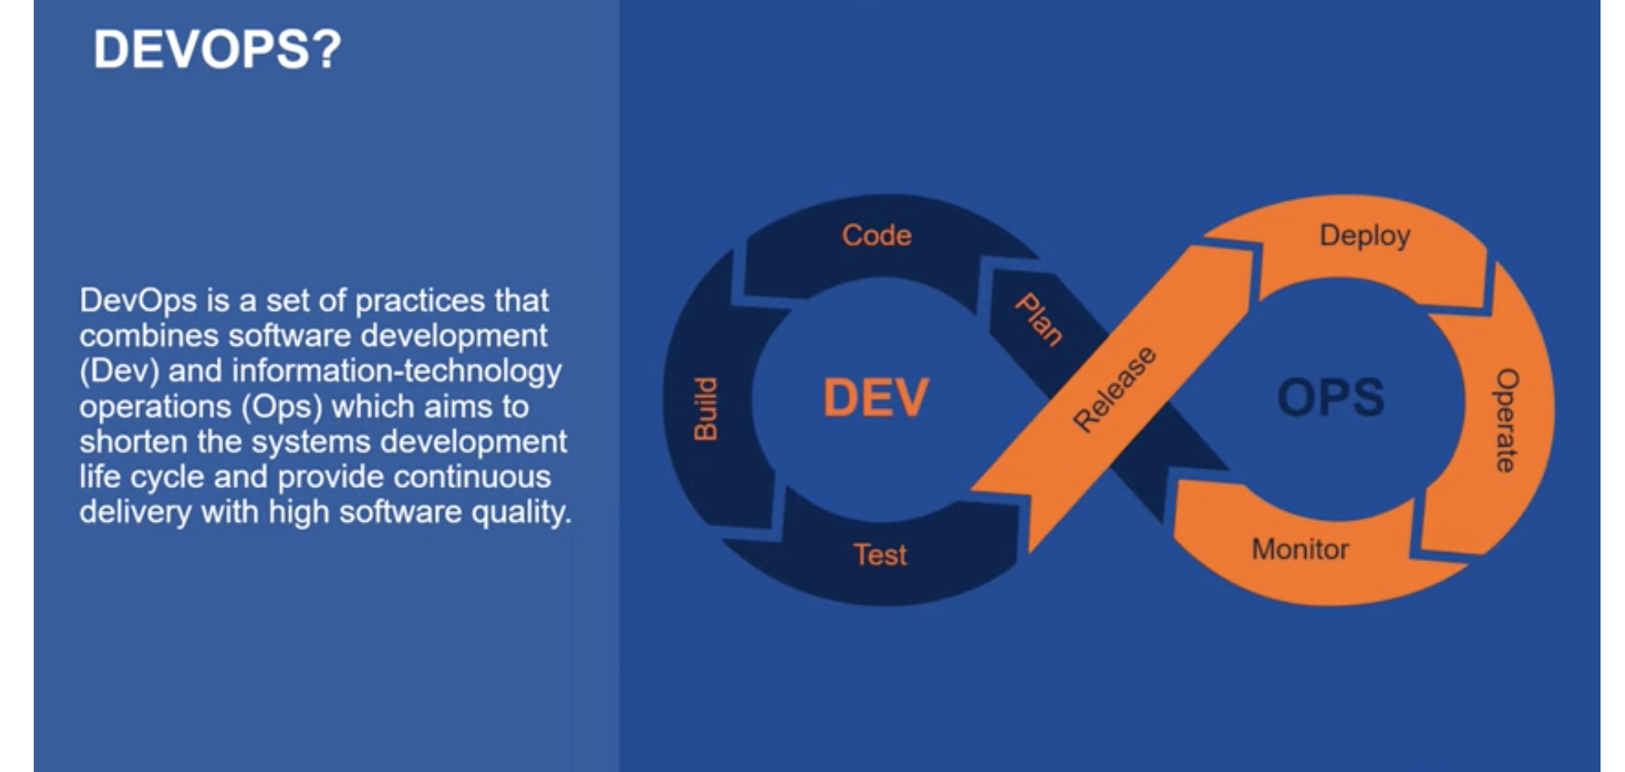

Slide 22
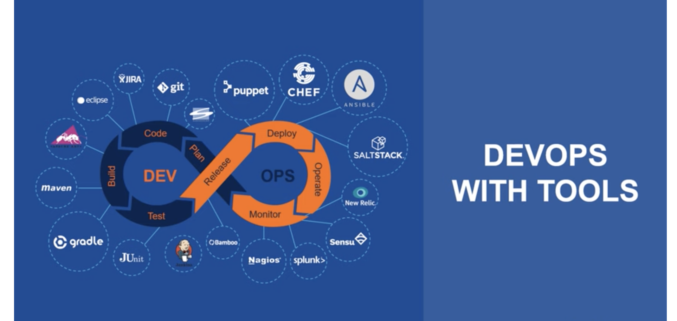

Slide 23
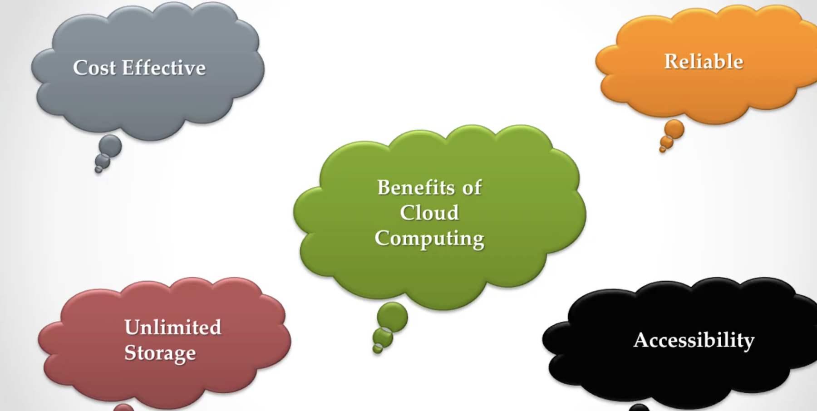

Slide 24
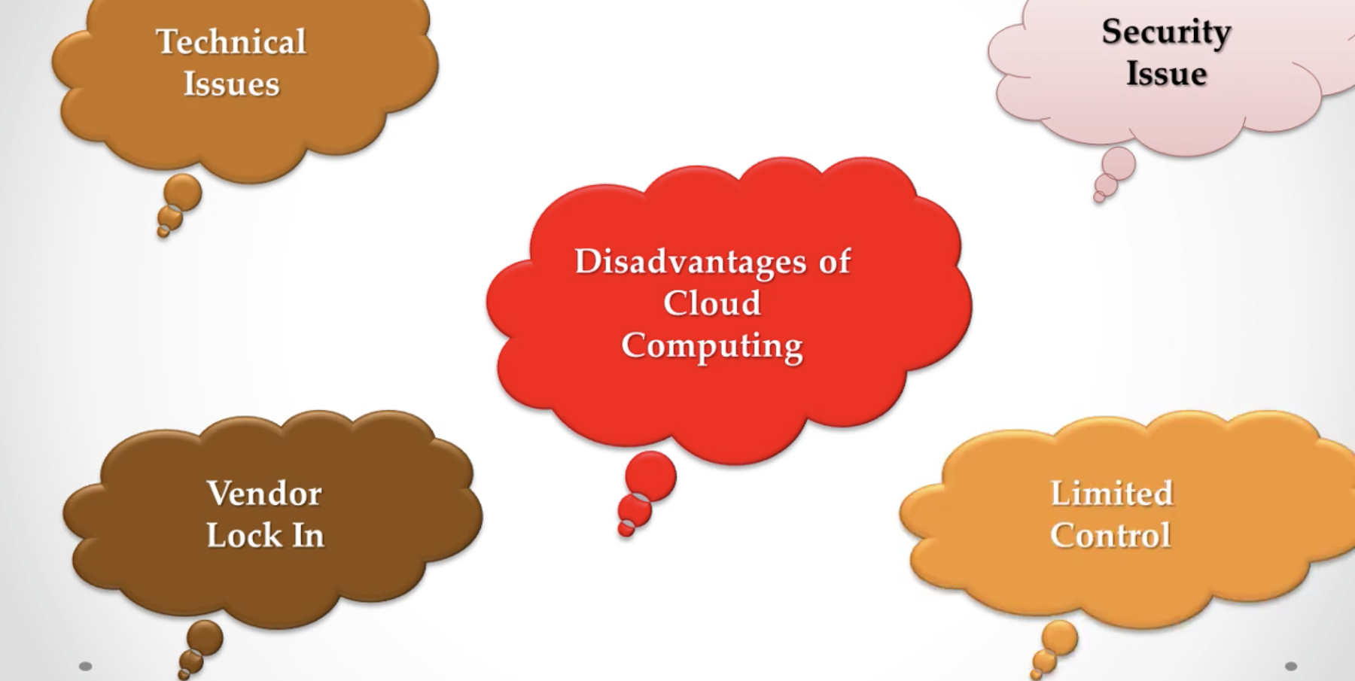

Slide 25
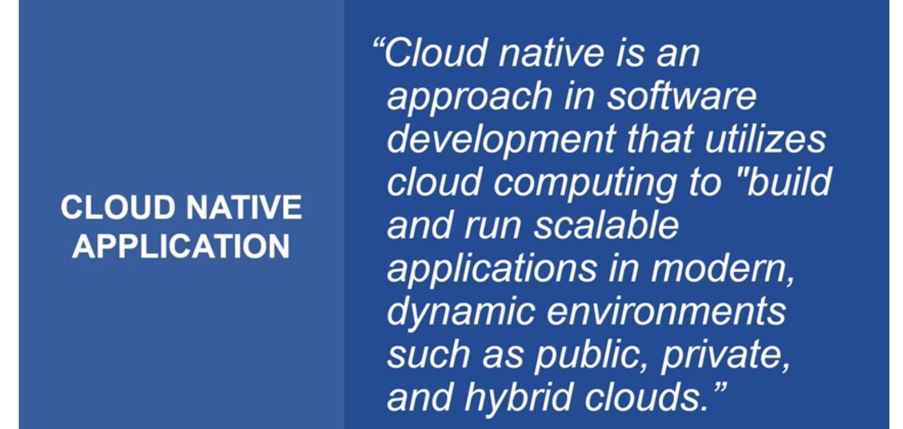

Slide 26
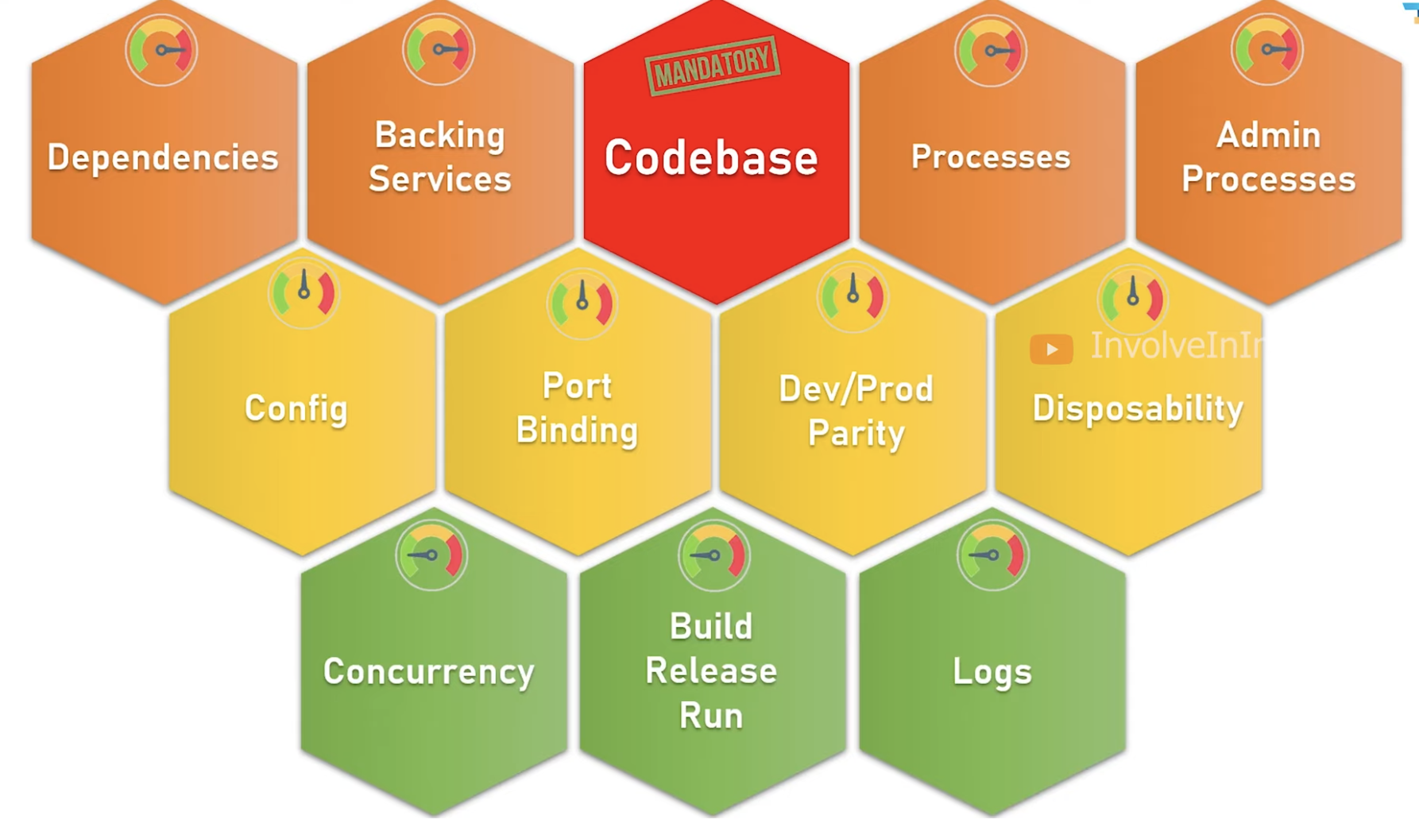
What Is the Twelve-Factor Methodology?

Slide 27
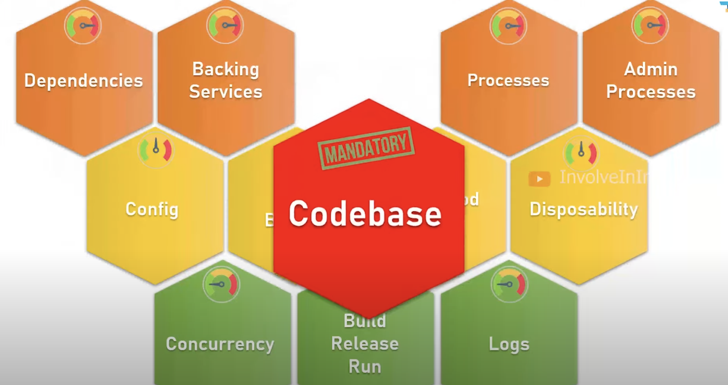

Slide 28
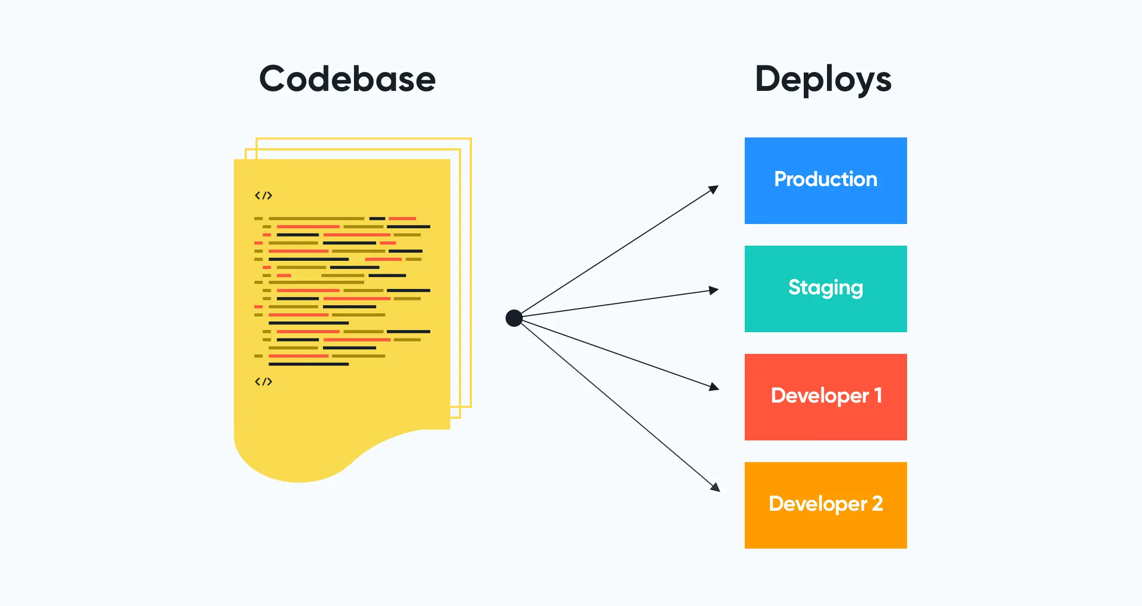
1 . Codebase The principle states that an app should be tracked in a single code repository and must not share that repository with any other apps.

Slide 29
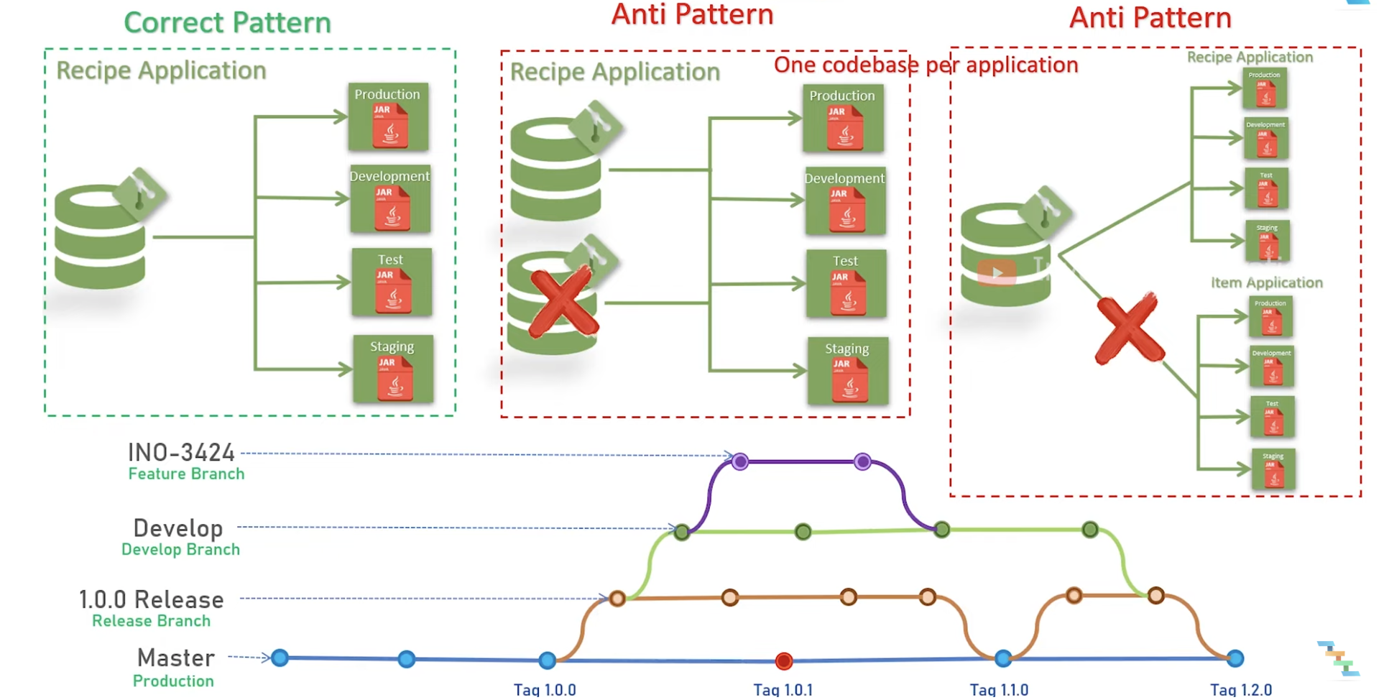

Slide 30
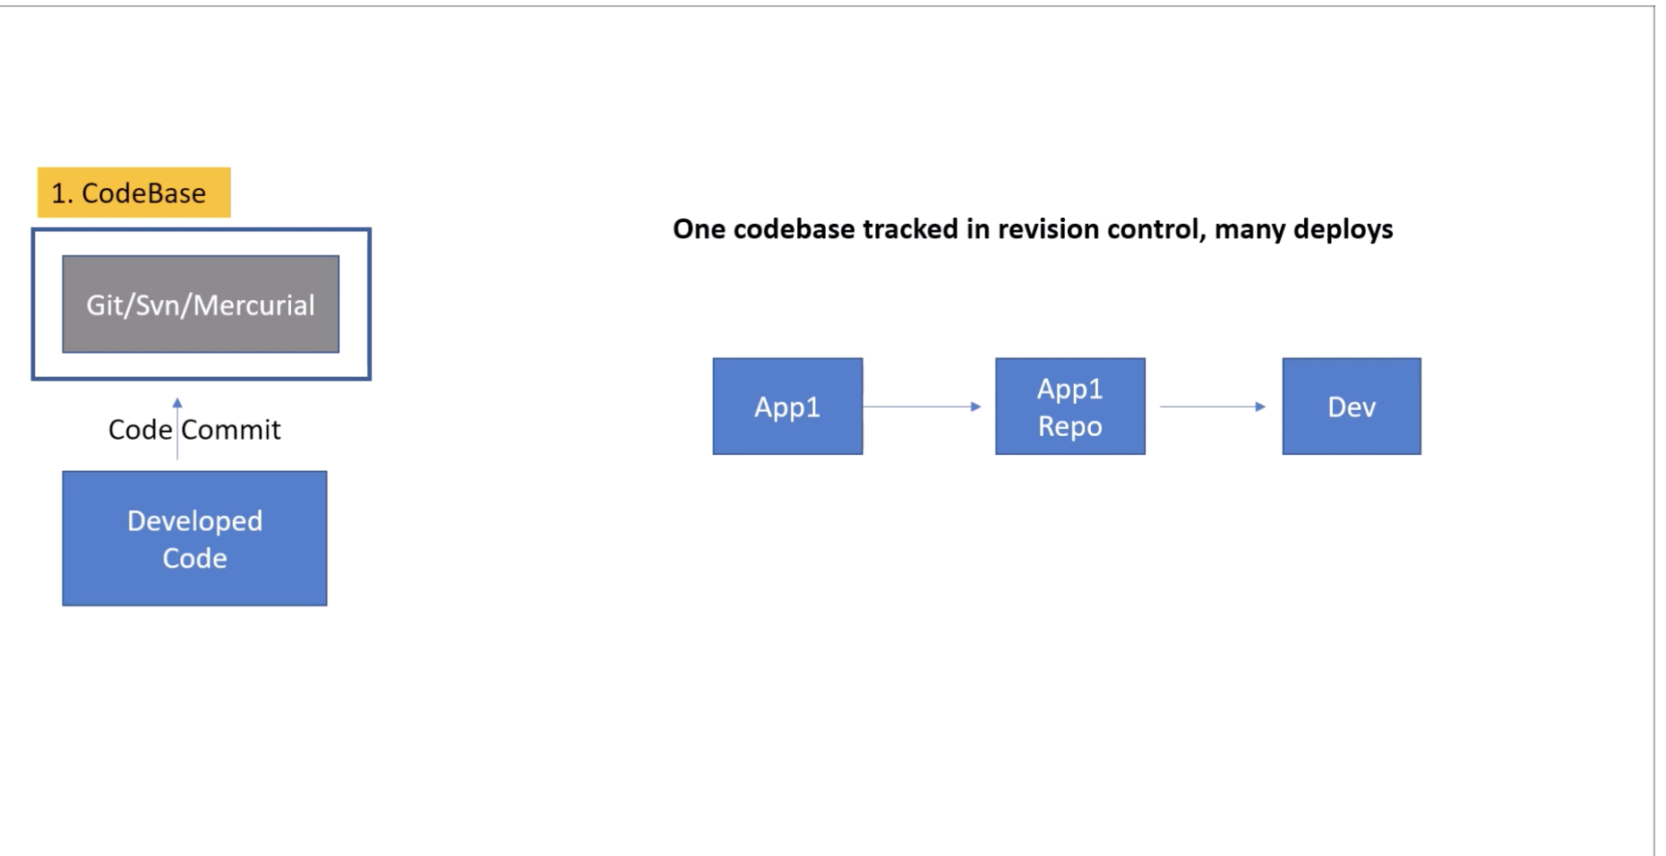

Slide 31
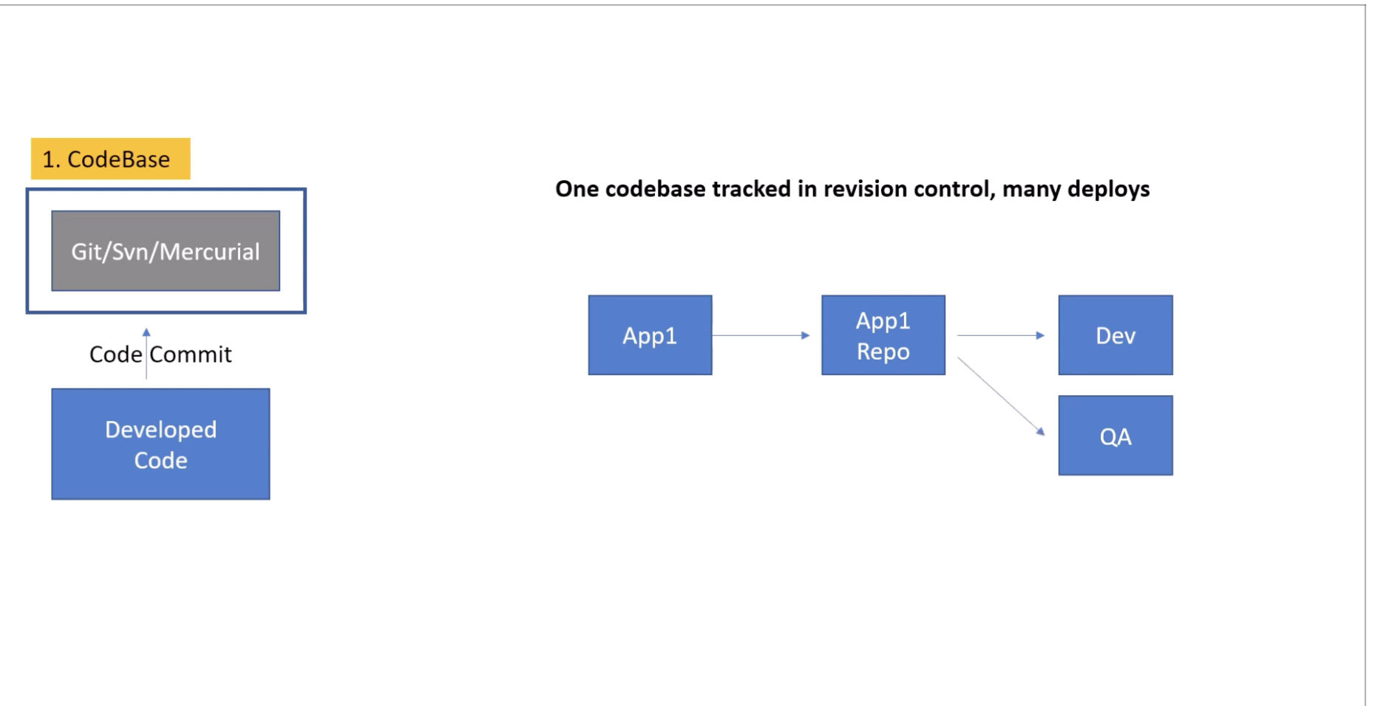

Slide 32
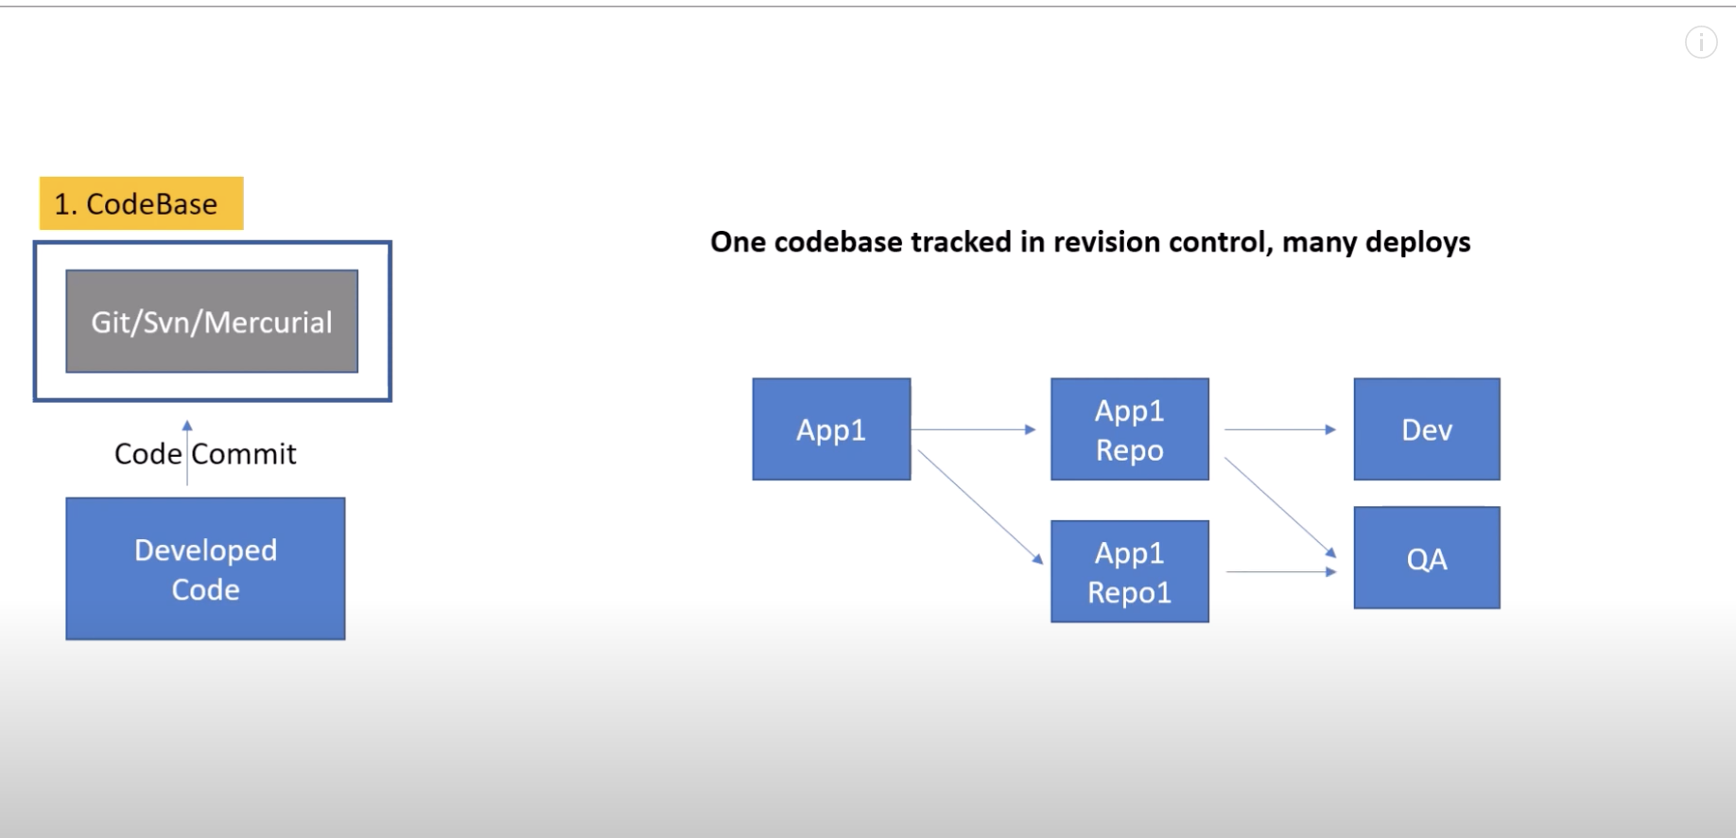

Slide 33
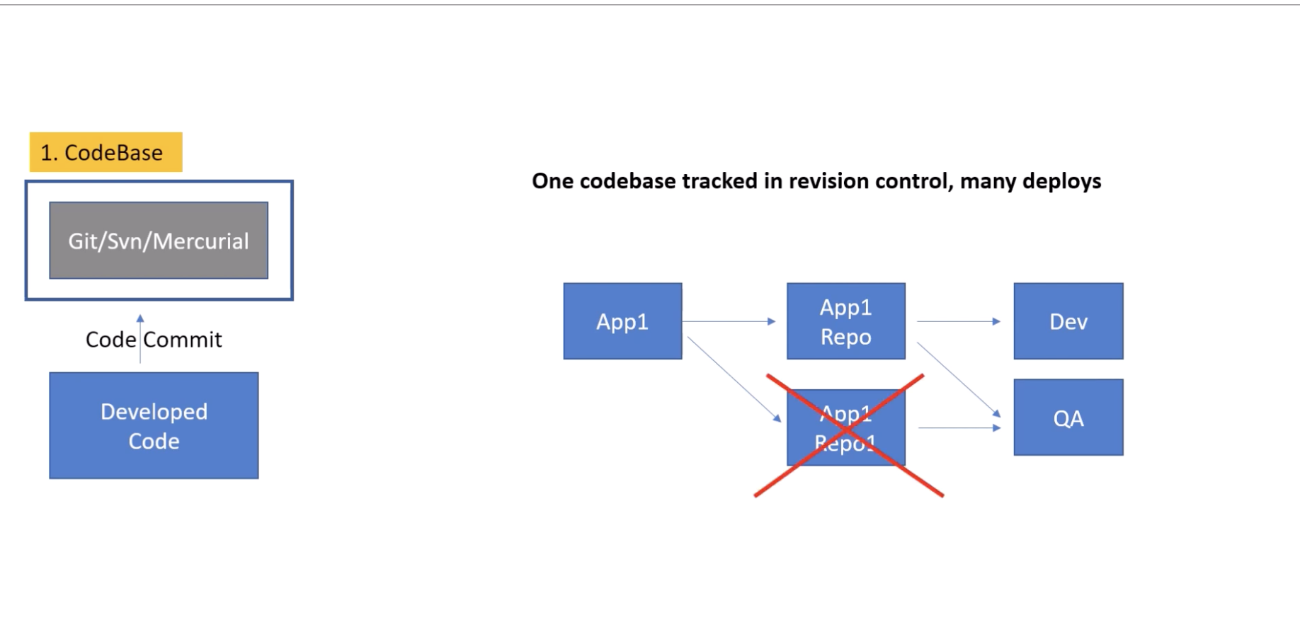

Slide 34
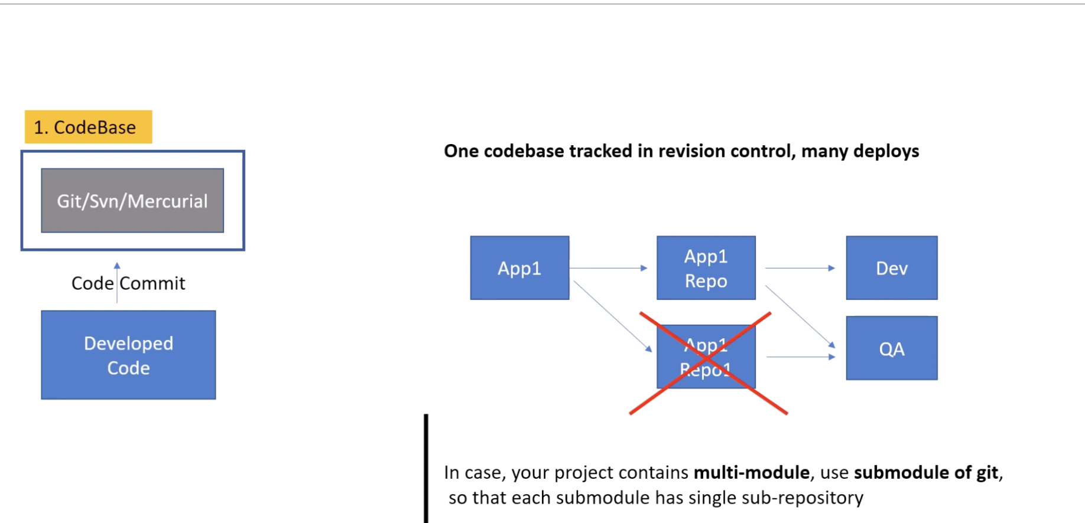

Slide 35
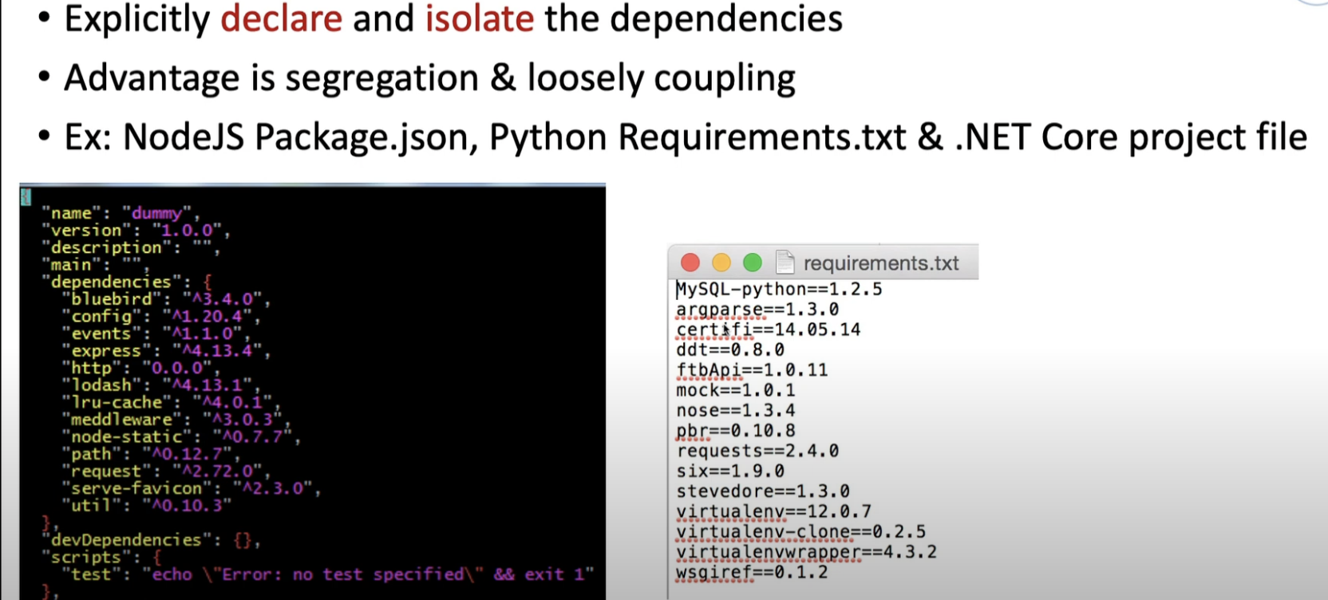
2. Dependencies
twelve-factor app should always explicitly declare all its dependencies.

Slide 36
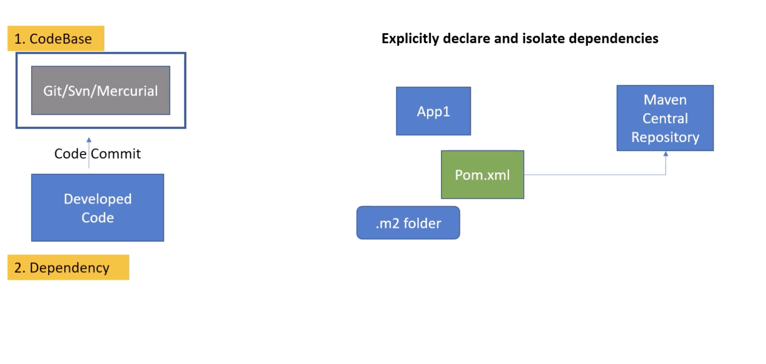

Slide 37
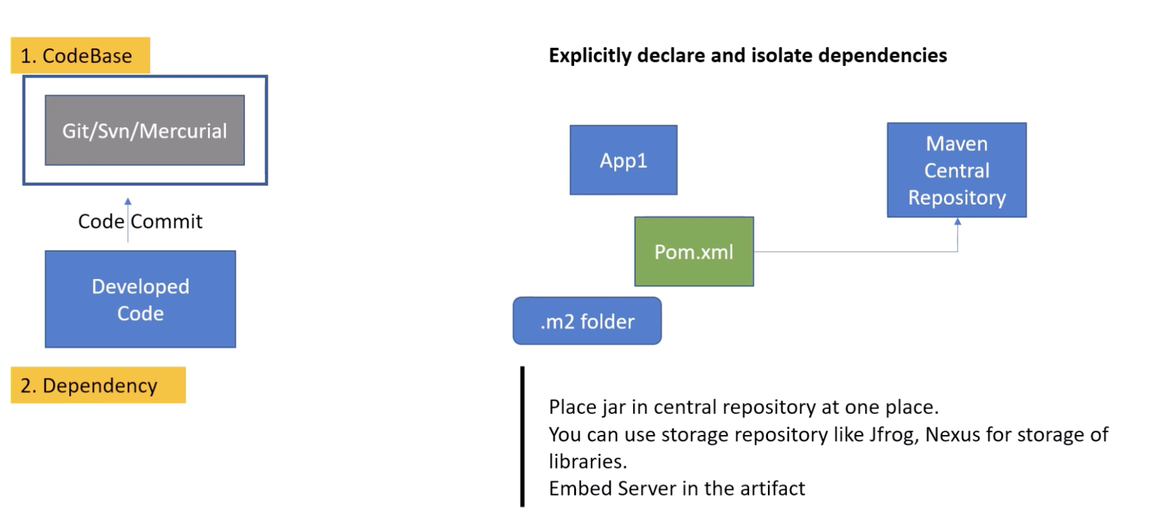

Slide 38
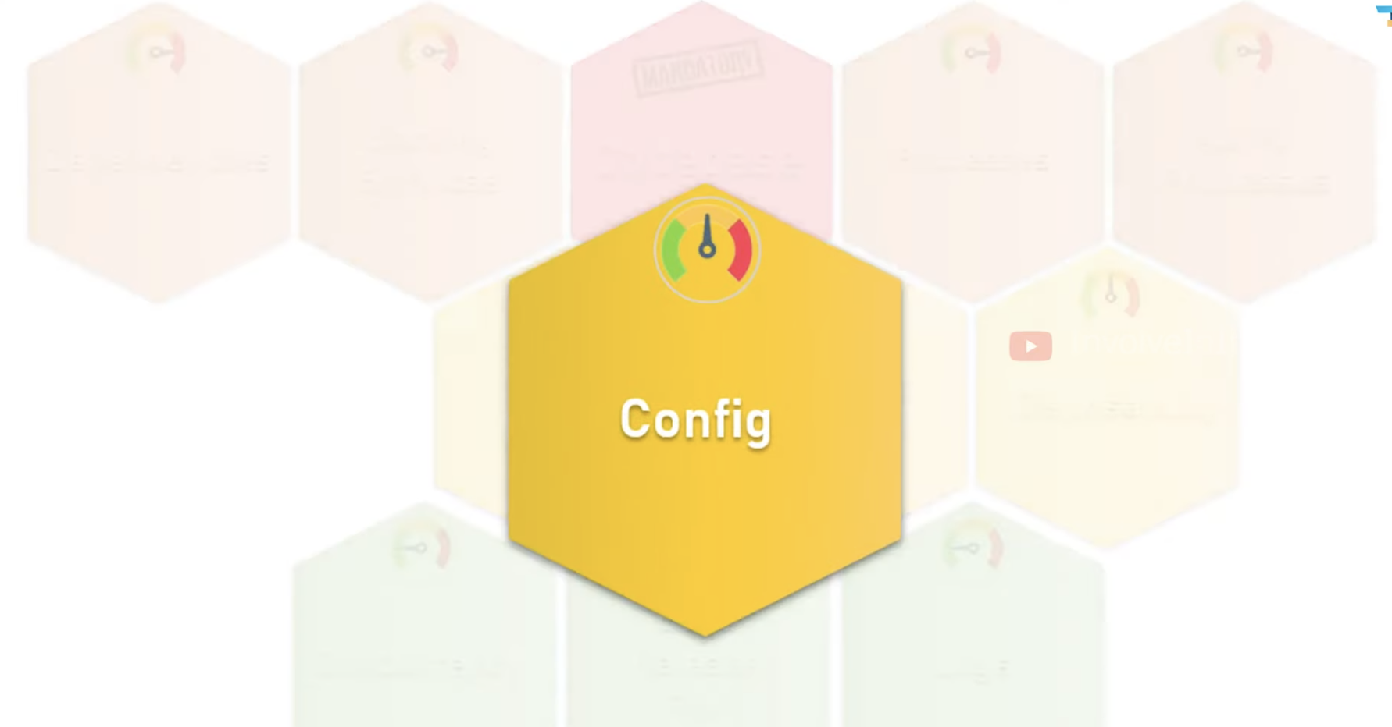


Slide 39
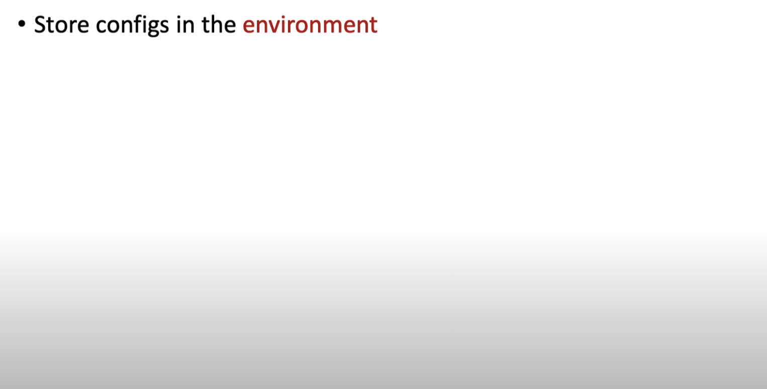
Externalize all such configurations that vary between deployments
3 . Configurations

Slide 40
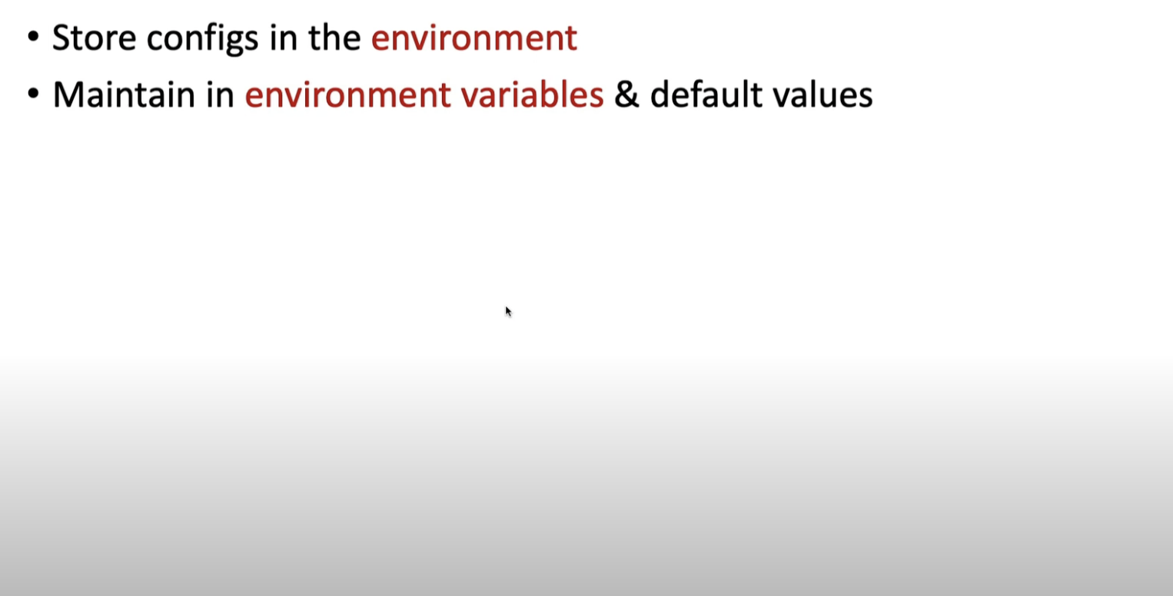
Configurations

Slide 41
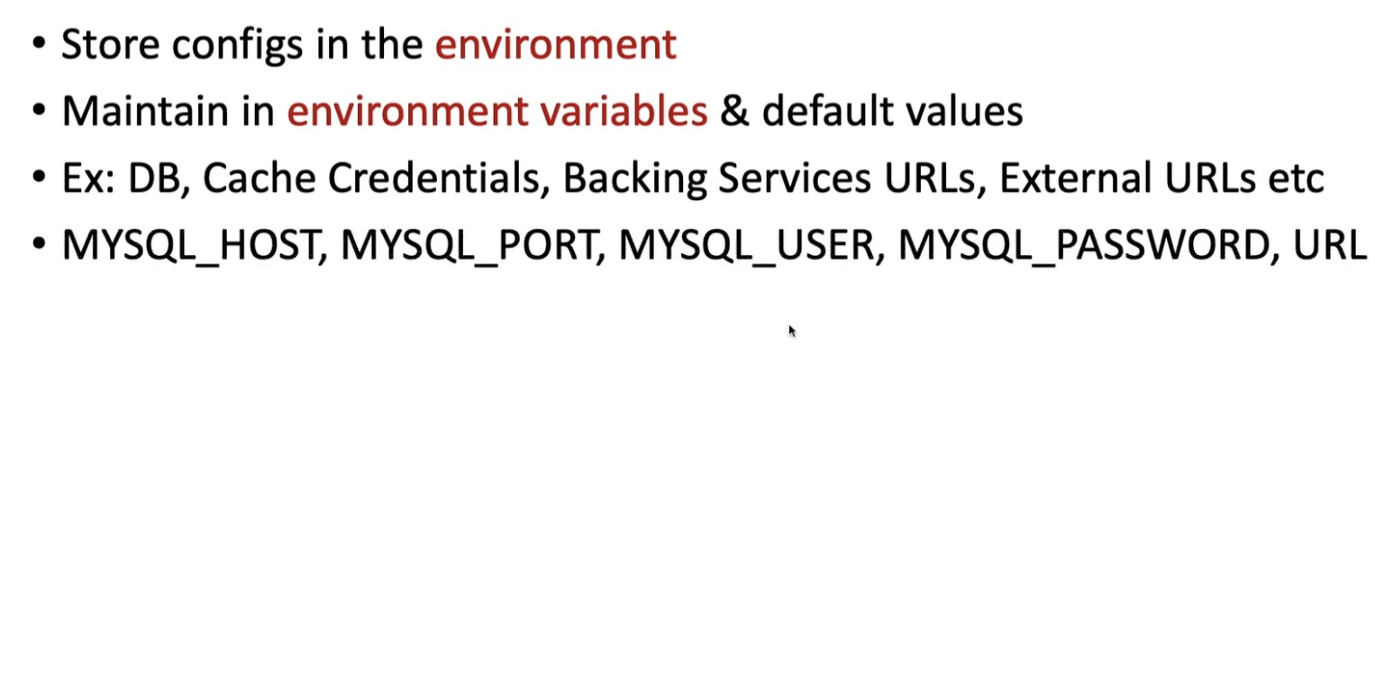
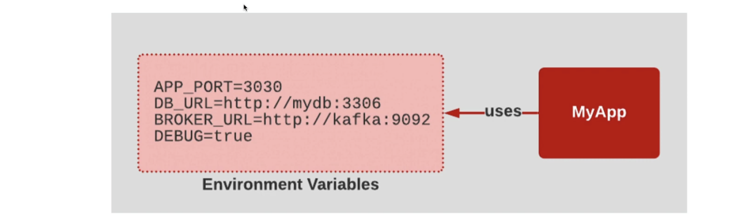
Configurations

Slide 42
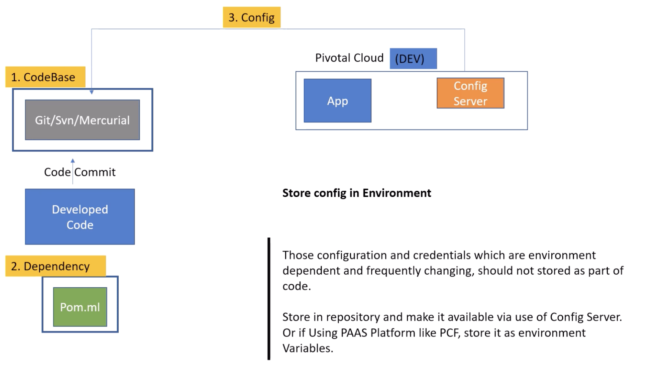

Slide 43
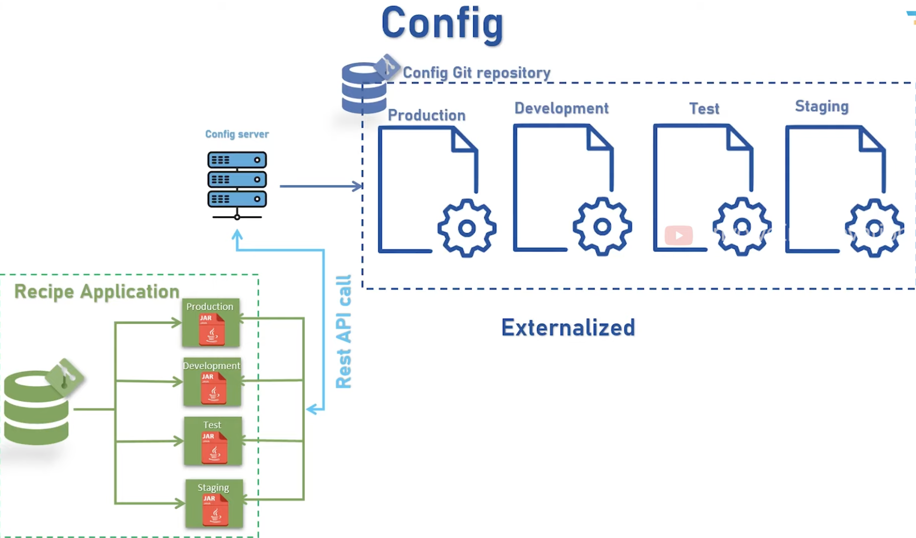

Slide 44
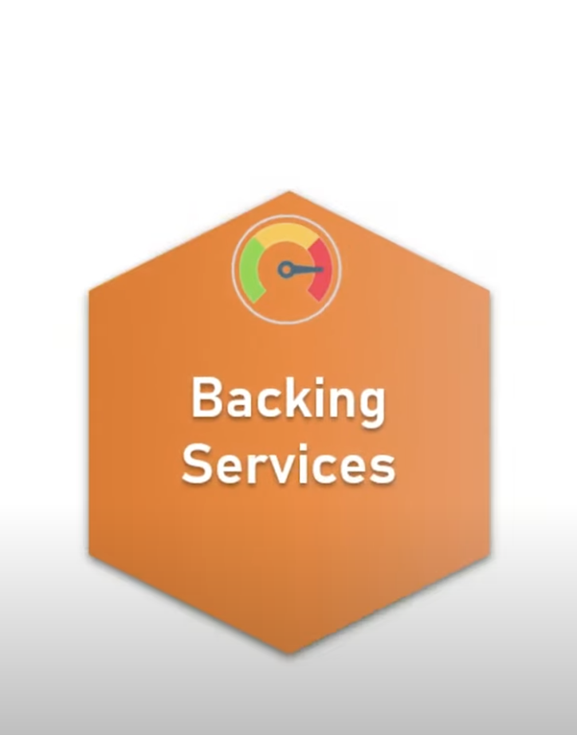

Slide 45
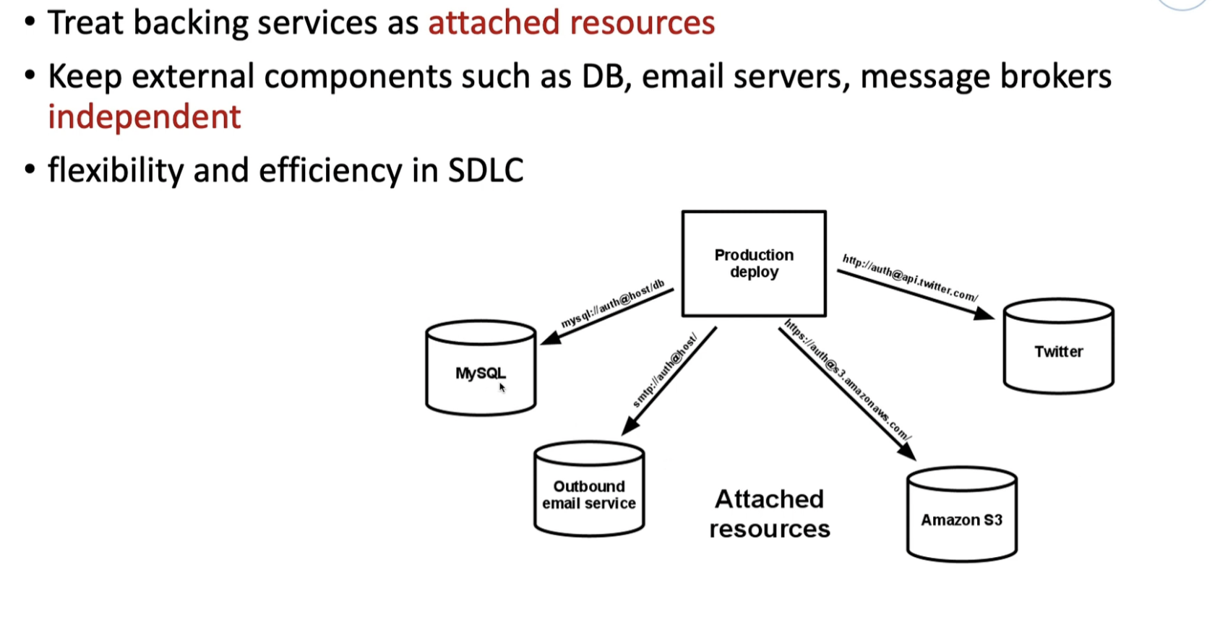

Slide 46
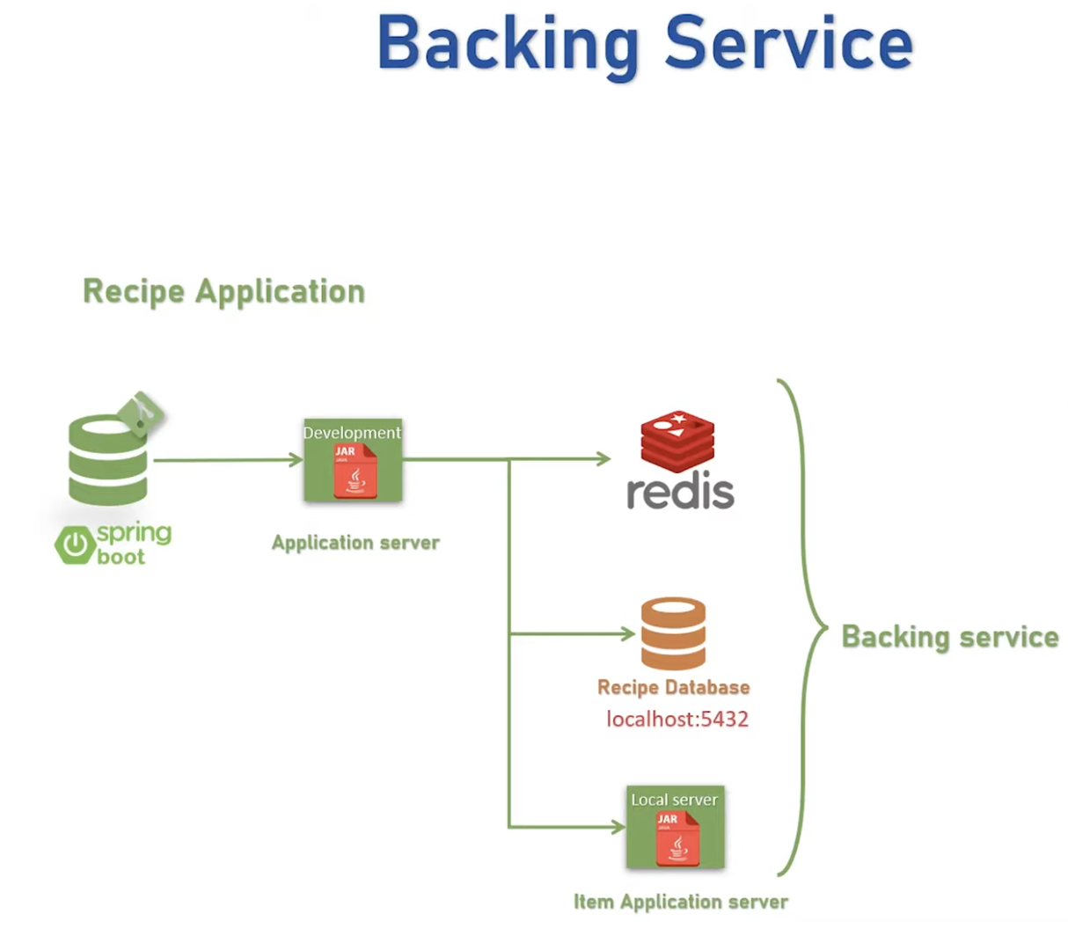
4. Backing Services
A twelve-factor app should treat all such backing services as attached resources

Slide 47
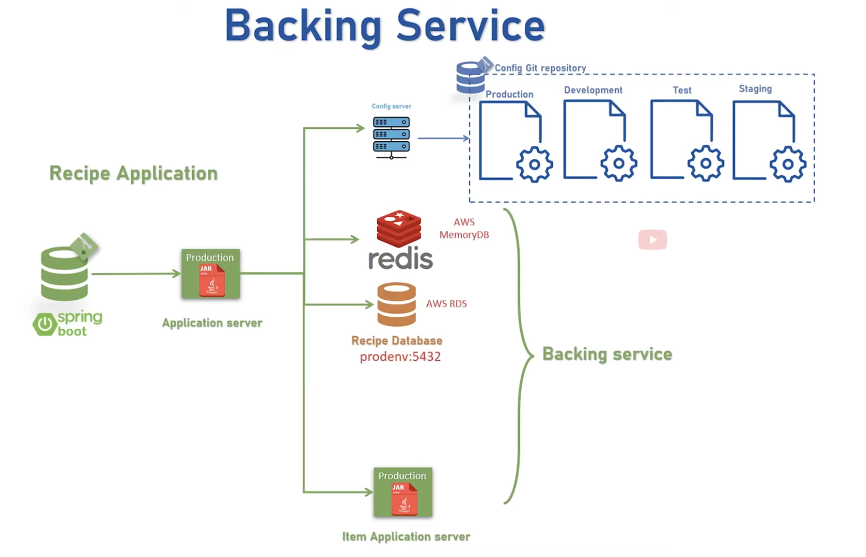

Slide 48
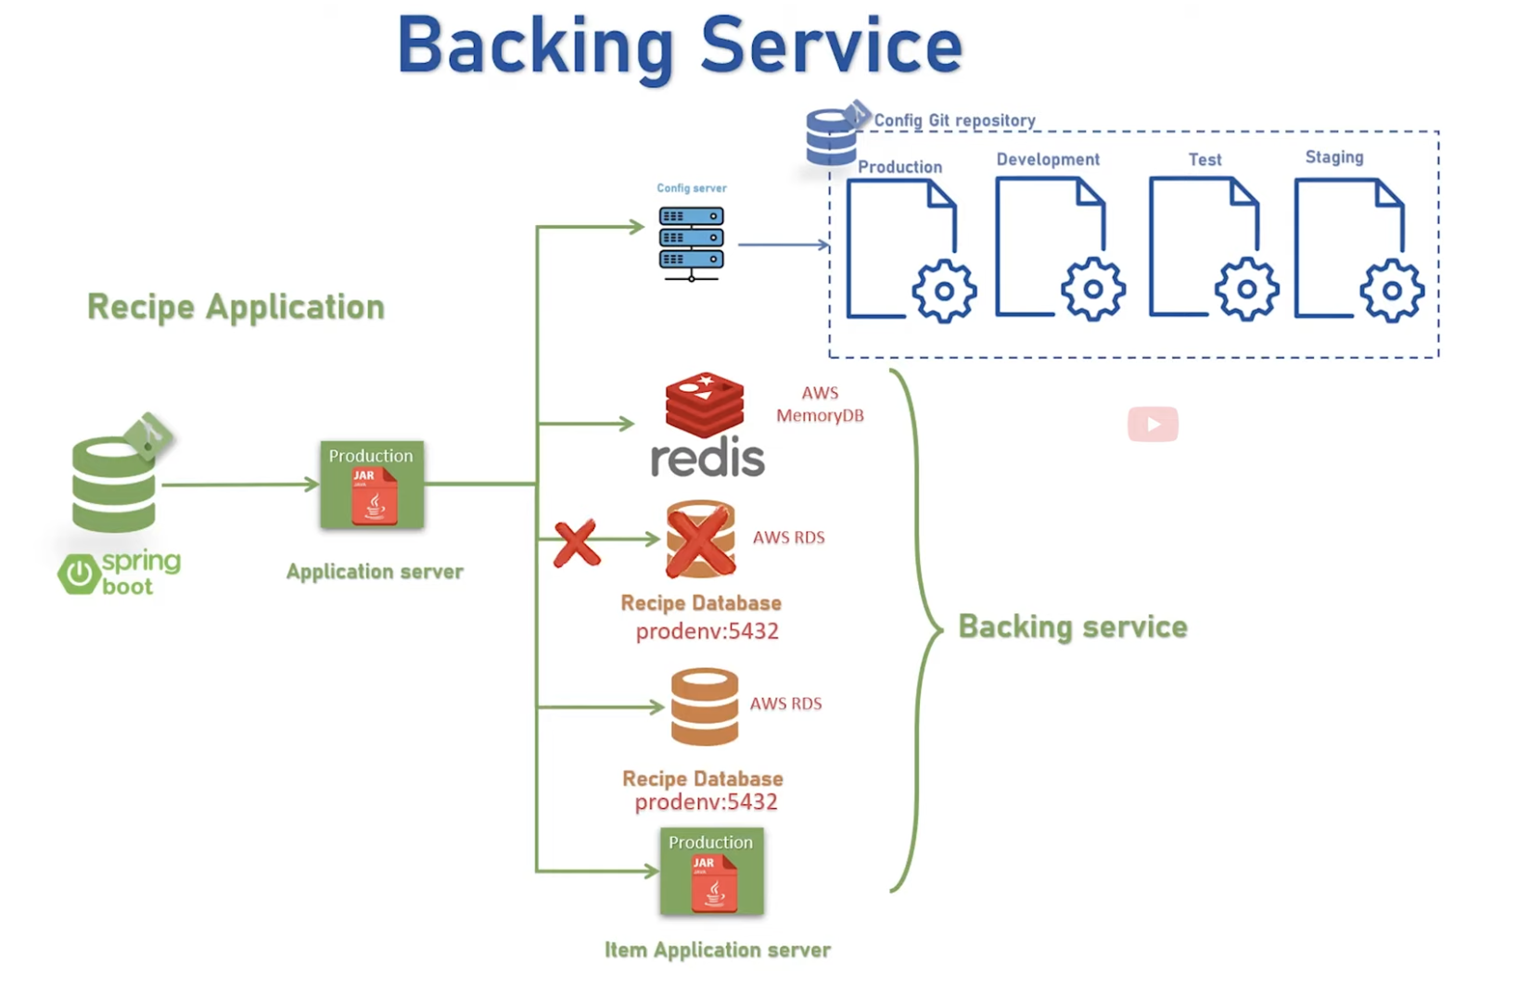

Slide 49
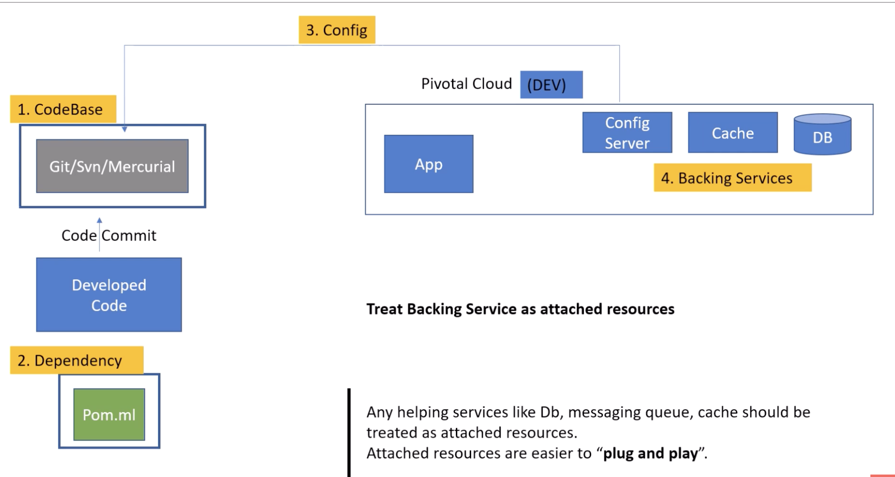

Slide 50
5 . Build, Release and Run
separates the process of converting codebase into a running application as three distinct stages:
Build Stage: This is where we take the codebase, perform static and dynamic checks, and then generate an executable bundle like a JAR. Using a tool like Maven, this is quite trivial:
Release Stage: This is the stage where we take the executable bundle and combine this with the right configurations. Here, we can use Packer with a provisioner like Ansible to create Docker images:
Run Stage: Finally, this is the stage where we run the application in a target execution environment. If we use Docker as the container to release our application, running the application can be simple enough:

Slide 51
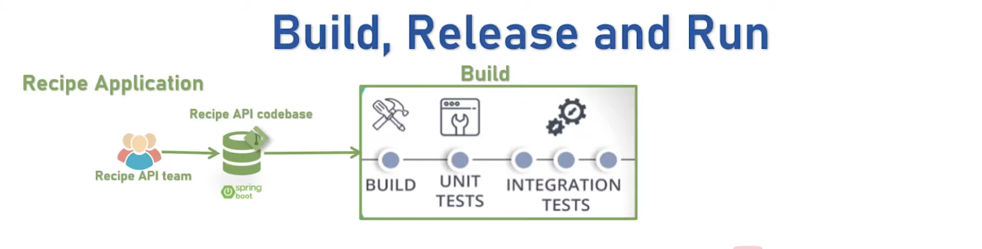



Slide 52


Slide 53


Slide 54

6. Processes
A twelve-factor app is expected to run in an execution environment as stateless processes

Slide 55


Slide 56



Slide 57


Slide 58


Slide 59


Slide 60

7. Port Binding

Slide 61
Twelve-Factor Apps are self-contained and independent processes that do not run under the control of a parent process. They expose their services by listening on a port. This also means that they can act as backing services for other apps.

Slide 62


Slide 63


Slide 64


Slide 65


Slide 66
Twelve-Factor Apps can be scaled out by running multiple instances of the same application. Stateless processes are easy to spin up and down as necessary, either manually or automatically based on metrics or a schedule. At the same time, apps with isolated dependencies minimise the risk of issues when they run side by side on different hosts.

Slide 67


Slide 68


Slide 69

8 .Concurrency
The twelve-factor methodology suggests apps to rely on processes for scaling

Slide 70


Slide 71


Slide 72


Slide 73


Slide 74
The Twelve-Factor App assumes that an application can go down at any time for any reason: elastically scaling resources to meet demand, hardware failures, or even intentional application restarts. Where possible, the app can gracefully dispose of any resources by handling an appropriate shutdown signal, like SIGTERM.
When designing apps around disposability, it helps if they are stateless. In that case, they only need to clean up the resources being used as part of request processing, as opposed to in-memory state that could be expensive to replenish (e.g., cache). Minimizing startup time is also useful, since running instances of an app can recover more quickly when they are physically relocated elsewhere.

Slide 75


9. Disposability
Application processes can be shut down on purpose or through an unexpected event. In either case, a twelve-factor app is supposed to handle it gracefully.
In other words, an application process should be completely disposable without any unwanted side-effects. Moreover, processes should start quickly

Slide 76



Slide 77


Slide 78


Slide 79

10. Dev/Prod Parity
The twelve-factor methodology suggests keeping the gap between development and production environment as minimal as possible.

Slide 80


Slide 81


Slide 82
Although the Twelve-Factor App suggests that developers entirely take over operational responsibilities, in practice this is not entirely necessary. It is quite common to have one or more DevOps engineers as part of a development team, ensuring that team goals are aligned across development and operational concerns, while at the same time making the best use of skill specialization.

Slide 83


Slide 84



Slide 85


Slide 86


Slide 87


Slide 88



11. Logs

Slide 89
Treat logs as event streams
The Twelve-Factor App is very clear that logs should be written to standard output and treated like an event stream. The application doesn’t care where logs are ultimately stored; it is up to the execution environment to pick them up and route them to the appropriate destination.
Conversely, an application that buffers logs in memory and periodically flushes them to a database is inherently flawed because:
It becomes coupled with the log storage, taking on additional dependencies to communicate with it, and the log storage can’t be changed without changing the application.
Log management has a direct and non-negligible impact on the application’s CPU and memory usage.
This is in violation of the process being stateless.
Therefore, it is recommended to decouple the application from its log storage. It’s also imperative to avoid logging sensitive data, such as personally-identifiable information or credentials.

Slide 90


Slide 91


Slide 92


Slide 93


Slide 94

12 Admin Processes
the twelve-factor methodology strongly suggests keeping such admin scripts together with the application codebase

Slide 95


Slide 96


Slide 97


Slide 98

Questions

